Slide 1
Advanced Data Science Programming
6. Test and Improve

Slide 2
Data Quality
To be effective, Machine Learning requires a large amount of high quality data
  ML does not know the “meaning” behind the data, it only sees the data and tries to figure out its meaning
Errors in the data look the same to the ML algorithm as just any other data
Eventually, ML should figure that out and start to ignore the errors
  However, if the errors continue consistently, it may never be corrected
Reducing the errors up front makes ML get to accurate results much more quickly

Slide 3
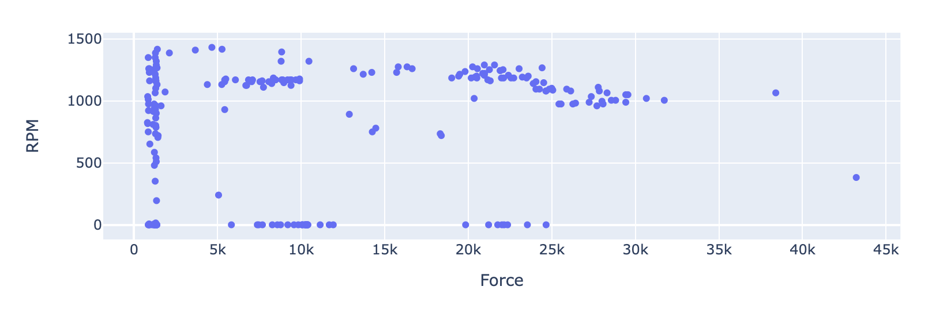
Low Quality Example
Inaccurate/inconsistent readings
Recording while stopped
Recording while speeding up/slowing down
Not enough data
  Data points are sparse
  Could be two possible trends

Slide 4
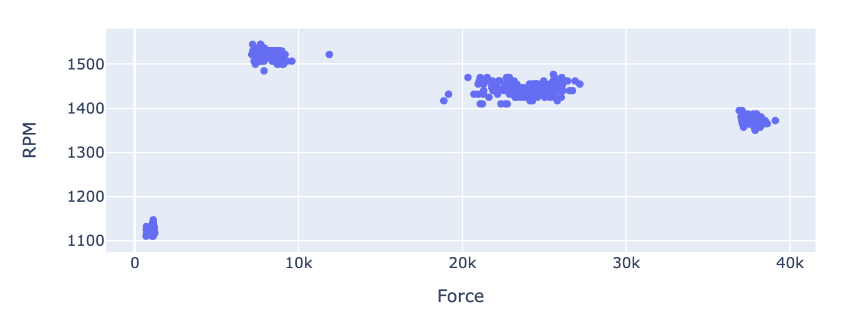
Better Quality Example
More accurate readings
No recordings when stopped or speeding up/down
Good amount of data
  Only one trend
  Lots of data points
  There are some gaps, however that is what we will fill in using ML

Slide 5
Data Quality Improvement Strategies
Improving Data Generation
Post-Processing
Making sure the data being recorded is correct:
  Adjusting or replacing sensors
  Accounting for sensor accuracy and/or margin of error
  Adjusting reporting frequency
Focus is more on data manipulation - changing the values
Improving the data you have recorded:
  Removing outliers
  Keeping only relevant data
  Using subsets
  Reordering
Focus is more on choosing which values to use, but not changing the values
  However, if this can be done earlier during generation, that is better

Slide 6
Improving Data Generation - Accuracy
Accuracy – How close the sensed value is to the true value
Do the values make sense?
  Within the normal range
  Vary correctly with changes
Consistency
  Does it read the same value every time with the same conditions?
Reaction time
  How quickly does the value change after changing conditions?
Notes:
Demo accuracy analysis

Slide 7
Improving Data Generation - Frequency
Too low
Too high
Condition changes can be missed
  Ex: temperature logger runs once per day
Lower volume of data
  Takes much longer to build up a good dataset
Can conditions change fast enough to matter?
  Ex: temperature logger runs once per second
Produces too much data
  Increases processing time with little to no benefit
  Can make events seem more common than they really are
Notes:
Demo frequency changes

Slide 8
Improving Data Generation - Relevance
Is all the data being recorded relevant?
  Recording during machine shutdowns
  Recording during adjustments
  Outside interference
    Ex: while recording, I bumped the fan and it stopped for a few seconds
Notes:
Demo pausable data recorder

Slide 9
Homework
Download the updated code from the class website and get it running on your device and PC
Record a test batch of data
  Move the motor up and down to at least 4 different locations
    Make sure one location is where the belt is slipping
  Record a few seconds at each location
  Pause recording while making adjustments
  Record at least 1000 rows
    More is better if desired
Email me a copy of the data
If you have any issues, contact me for a coaching call

