Slide 1
Advanced Data Science Programming
3. Arduino & CircuitPython

Slide 2
Arduino
Open-source electronics platform consisting of a microcontroller with a number of input and output pins
Easy to use
Inexpensive
Low power consumption
Straightforward programming using C/C++
Many available libraries, similar to Python
Hundreds of different boards available from many suppliers

Slide 3
Arduino Program
Written in C or C++
Two functions:
setup() – Runs once during board startup
Used to specify inputs/output modes, initialize devices and variables
loop() - Runs repeatedly starting when setup() finishes
Used for the operational code
When control reaches the end, starts back up at the beginning
Important to let it reach the end since some boards do timing/cleanup/other management tasks between loops

Slide 4
Input/Output
Input/Output uses electrical connection points – pins
Must select:
Digital or Analog
Input or Output
Each board runs at a specific voltage - Vcc
3.3v
5v
12v (very rare)
Higher voltage can damage the board
Lower voltage typically won’t cause damage, but also won’t operate correctly

Slide 5
Input/Output Types
Digital – state is either on or off
Analog – state is any point along a scale
Input – detects if voltage is above/below threshold
Typically about half Vcc with some room on either side
Output – sets voltage to Vcc or 0v
Scale determined by processor architecture:
8-bit: 0-255
10-bit: 0-1023
16-bit: 0-65535 – our class project
Value corresponds to the proportional voltage from 0-Vcc
Input – detects current voltage level
Output- sets voltage level

Slide 6
Other Input/Output Types
There are other methods of input/output available:
I2C/SPI/UART
Communications with devices
PWM – Pulse-Width Modulation
Audio
LED dimming
Drive servo motors
And others…
We won’t cover these in class

Slide 7
Serial Connection
Communication with the board is done via serial connection over USB
Transferring program code
Sending/receiving data during runtime
Connection can be made in multiple ways:
Mac – screen /dev/tty.usbmodem####
Windows – need to install a terminal program
Recommended way is to use a code editor that has a built-in serial terminal
Arduino IDE – for C/C++ coding
Mu – for Python coding – We will use this one

Slide 8
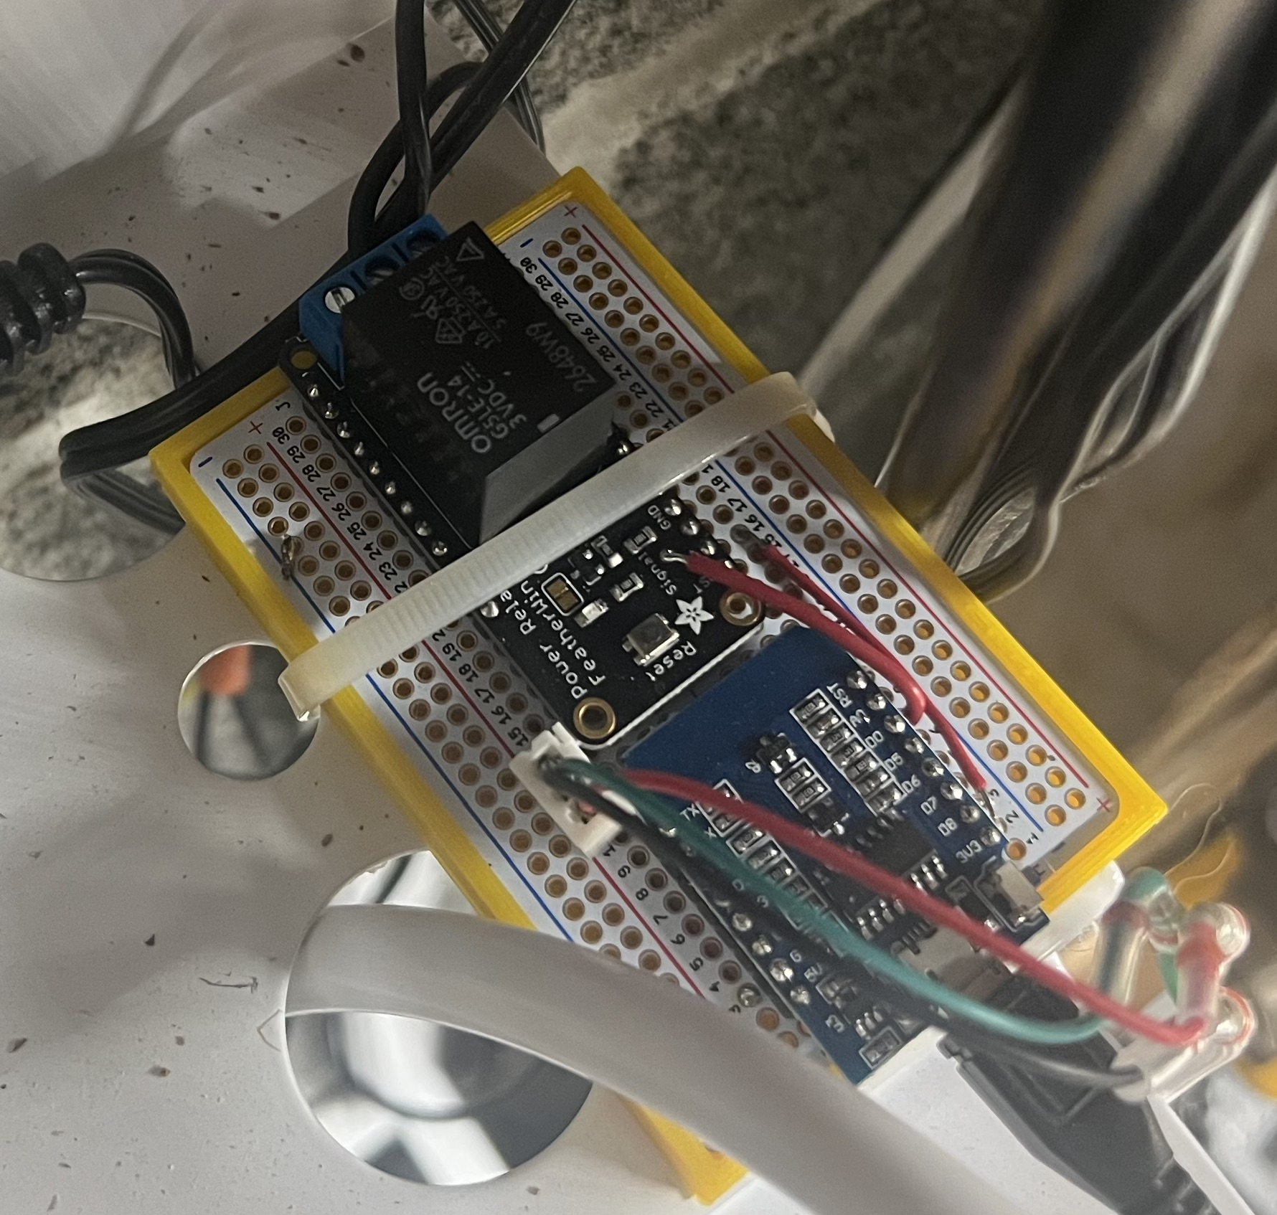
Example – Water Filter Controller
Before
After
RO filter with electric pump
Drain connects to kitchen sink – loud when running
Runs based only on water pressure
Annoying to run during day
ESP8266
Built-in WIFI
Output – digital connection to Relay board
To switch 120V
Input – Analog connection to Pressure Sensor
Retrieves current time via WIFI
Normally only runs 1-2 am
Runs during day if pressure is extremely low
Notes:
Show water program

Slide 9
CircuitPython
Python tools & libraries for microcontrollers
As alternative to using C/C++
Not all microcontroller boards are supported
However, many are: https://circuitpython.org/downloads
Our boards already have CircuitPython installed
Aims to make programming these boards easier
Python is easy to learn
No compile steps
Many libraries available
Just needs a regular text editor and USB connection
No start() or loop() functions – Instead operates just like regular Python code
Do setup in the beginning
Enter into a loop for operational code
When control reaches the end, the program stops

Slide 10
Example – Traffic Light Simulation
Red/Yellow/Green LEDs, connected to 3 digital outputs
Done two ways:
ESP8266 – using C
Trinket M0 (same as our class project uses) – using CircuitPython
10 seconds on green, 3 seconds yellow, 10 seconds red
Notes:
Show both versions

Slide 11
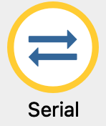
CircuitPython
CircuitPython also supports interactive mode (REPL)
Connect via USB
Launch Mu editor
Open the serial console:
If the program is running, you will see the output – press Ctrl-C to quit it
Press Ctrl-D to enter REPL
Type Python code as usual
Press Ctrl-D again to quit REPL and go back to the stored program
Notes:
Demo REPL – make yellow light blink

Slide 12
Homework: Install Mu Editor and run example
Download and run the installer
https://codewith.mu/en/download
Connect the device with USB
You should see a drive named CIRCUITPY
Windows users might need to install drivers – if this isn’t showing up or it’s not working correctly, contact me for a coaching call
Run Mu Editor
Download example code
https://pages.process-solutions-group.com/sites/ds2023/301/3 - arduino and circuitpython/homework.py
Open the file in Mu (or copy/paste into the editor)
Save
Make sure it saves on the CIRCUITPY drive as code.py
Start the serial console
You should see numbers being printed
Move the motor mount up and down and the numbers should change
Notes:
Go through homework steps

