Slide 1
Intermediate Data Science Programming
9. Running on Schedule or as Continuous Service

Slide 2
Why Schedule or Continuous Service?
Some projects are just run on demand:
Machine stopped – run report on recent usage
Best to not use schedule or service
Optional: Create shortcut
Some projects are used periodically:
Update inventory reports weekly
Use Scheduler
Some projects always need to be available:
Dashboards
Use Service

Slide 3
Prepare Launching Method
Python scripts should not be run directly from shortcuts/schedules/services
Need to select python environment
Harder to maintain/make changes
Better to create a launcher:
Windows - *.bat file
Linux/Mac - *.sh file
Shortcut/Schedule/Service calls the launcher, and the launcher then performs all setup steps:
Change to correct directory
Load python environment
Optional:
Pass parameters to program
Cleanup from previous runs

Slide 4
Create Launcher
Windows - *.bat file
Linux/Mac - *.sh file

Slide 5
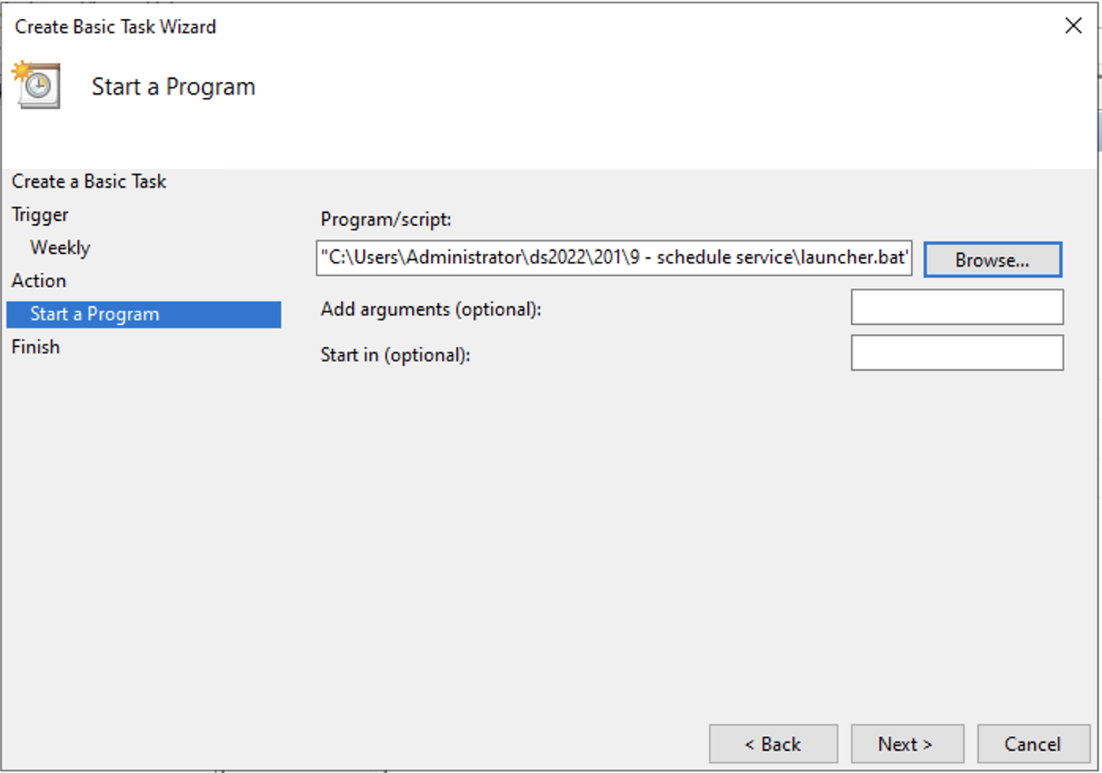
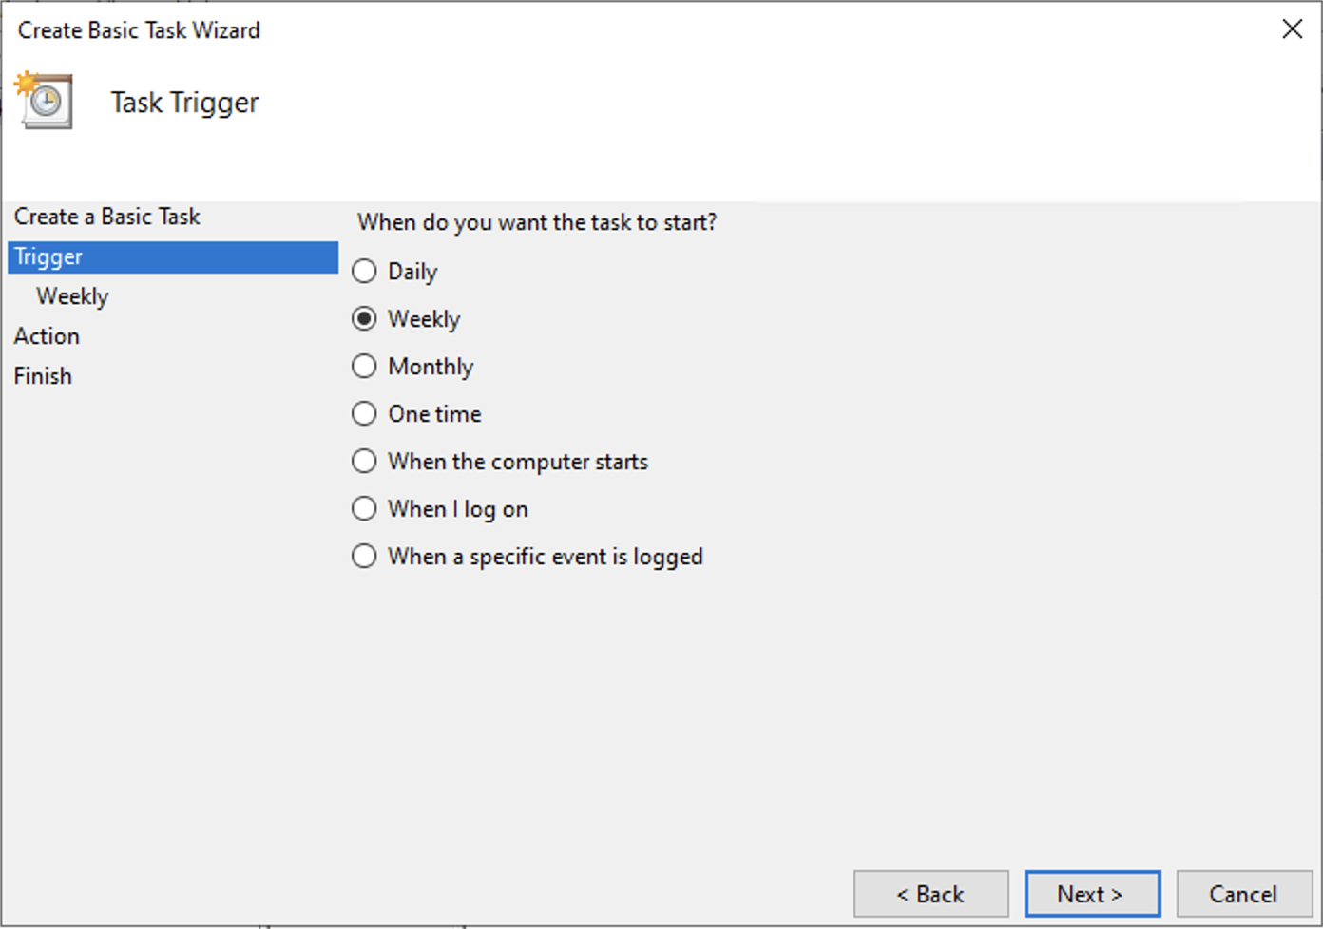
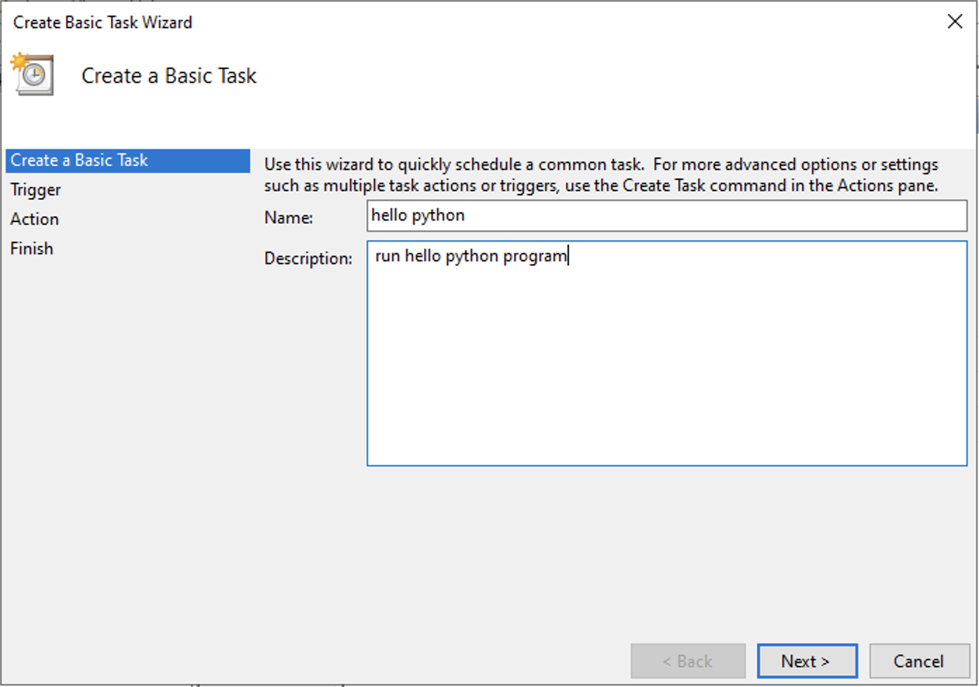
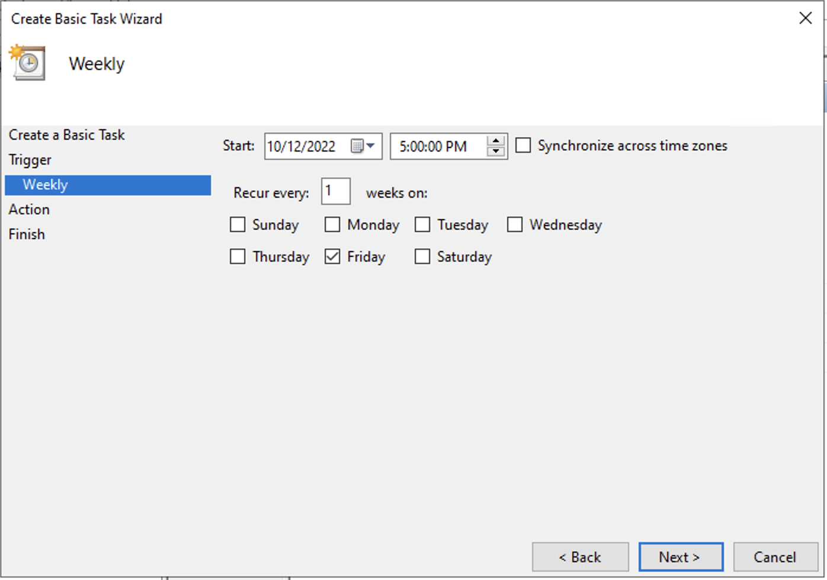
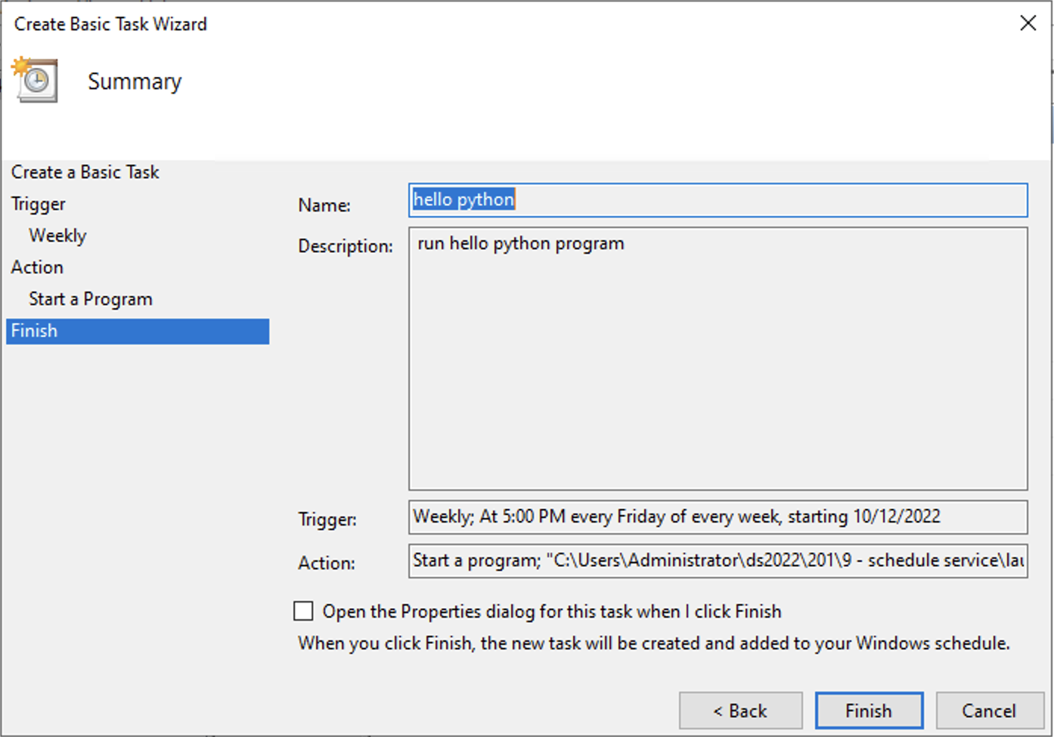
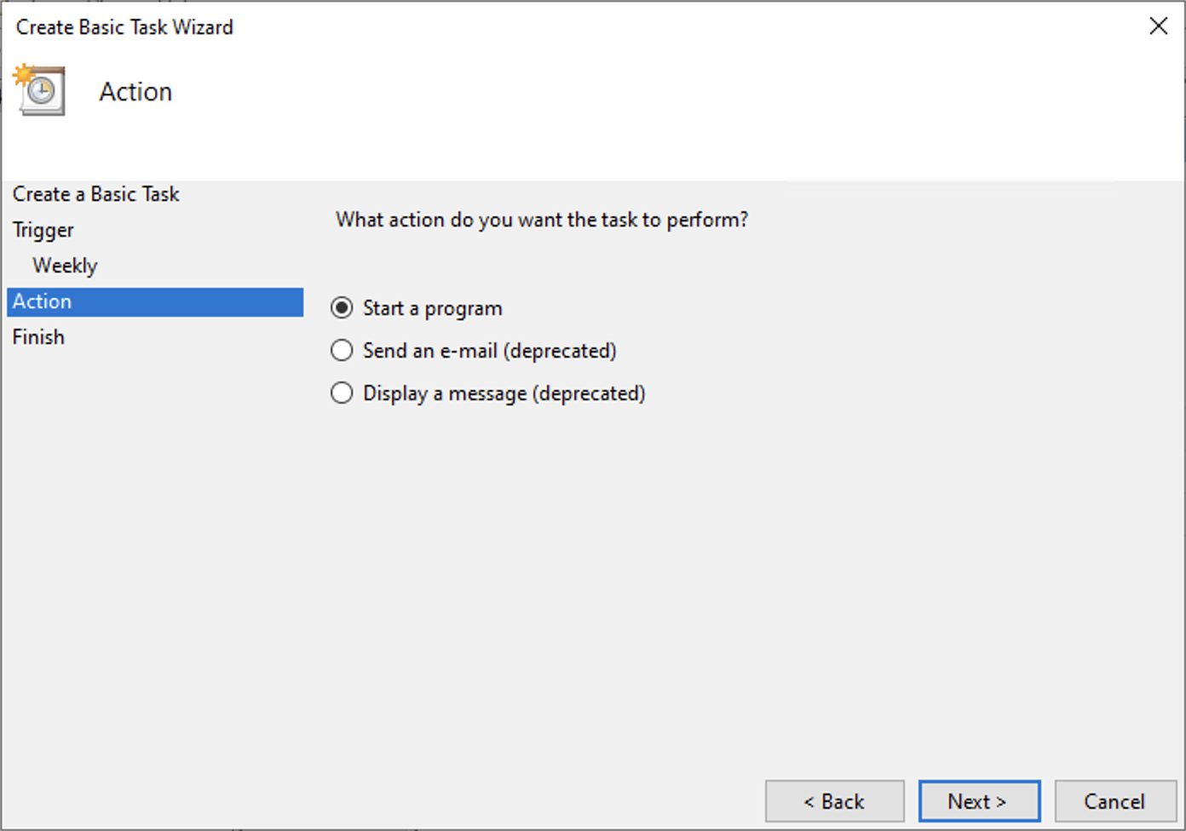
Run on Schedule - Windows
Run Task Scheduler
Select Create Basic Task…
Enter name and description
Select Trigger type
Enter Trigger details
Select Start a program
Select .bat file
Double-check values and then click Finish

Slide 6
Run on Schedule – Linux/Mac
Start Terminal
Run crontab –e
Enter a line with the following format:
minute hour day month day_of_week command
Use * for any item that is “don’t care”
Ex – run weekly on Friday at 5pm
0 17 * * 5 ~/ds2022/201/"9 - schedule service”/launcher.sh

Slide 7
Run as Service - Windows
Install a tool called NSSM
https://nssm.cc/
Contact me to set up coaching call for help with setup
Open a terminal and run the command:
nssm install ”service_name”
Select launcher .bat file for Path and click Install Service
It will now operate like a regular Windows Service

Slide 8
Run as Service – Linux/Mac
Create service file
/etc/systemd/system/dashboard.service
Install service
sudo systemctl enable dashboard.service
Start/Stop service
sudo systemctl start dashboard.service
sudo systemctl stop dashboard.service
Contact me for coaching call for help

Slide 9
More Robust Server for Dash
The built-in server for Dash is intended just for testing
If you plan on allowing multiple users, or if your app will be a critical service that needs to keep running, you should use an official WSGI server
I recommend gunicorn
https://gunicorn.org
Contact me for help setting up

Slide 10
Homework: None!
No assigned homework
Contact me for help with getting your project running on schedule or service
Reminder – Send me your shipping address to get a parts kit for the machine build in the Advanced class

