Slide 1
Intermediate Data Science Programming
6 – Dash: Introduction and Simple Layouts

Slide 2
Dash - Intro
Dash is a library from the makers of Plotly for building interactive web dashboards
It actually does more than just dashboards, it enables web Single Page Applications (SPA)
Traditional web apps are composed of multiple pages, each click usually causing a new page load
SPAs load the page once, and then update the contents dynamically
Benefits:
Allows better responsiveness
App state held throughout user session
Feels more like native app
Drawbacks:
Browser history doesn’t work without specifically coding for it
Large projects can become difficult to manage and require more powerful client systems
Dash does support multi-page apps, which helps manage this, but we won’t cover it in this class

Slide 3
Anatomy of a Dash App
Initialization
Initialization
Load initial data
Configure Dash
Layout
Build HTML webpage with code
Tag items to be monitored and updated
Callbacks
Monitor for changes and update items appropriately
We’ll cover this next session
Server
Listens for incoming requests and delivers responses
Layout
Callbacks
Server

Slide 4
Sidebar - Flask
Dash uses a library called Flask for the web server
Flask is a web application framework intended to be lightweight and simple to use
We’ll only cover some basics
More info available at: https://flask.palletsprojects.com

Slide 5
Initialization
Loading Initial Data
Configure Dash
On startup, the app should load data that:
Does not change over time
Does not change by user actions
May take a long time to load or compute
Create the Dash instance:
dash.Dash()

Slide 6
Dash Configuration Options
Parameters passed into the Dash() constructor
Required:
name – The module/package name for the app. Used internally for finding assets.
Best practice: use __name__
Optional:
server – the Flask server instance. If not specified, Dash creates one
external_stylesheets – load CSS stylesheets from an external server
Used to change look and feel
prevent_initial_callbacks – Dash normally executes callbacks once when their components are initially created, with empty inputs. You can prevent it per-callback. Pass True here to prevent for all callbacks.
Many others: https://dash.plotly.com/reference#dash.dash

Slide 7
Layout
A Dash app is served as a regular HTML web page
Instead of coding directly in HTML, Dash uses python code
Use app.layout field to set the page content
Dash will convert it internally

Slide 8
HTML Primer
<div> – division (section)
Container for other elements
<h#> - heading
Displays larger, bolded text
Numbered 1-6 for large to small
<br> - break
Inserts a line break
<hr> - horizontal rule
Draws a line across the container
<p> - paragraph
Groups text together for spacing and formatting
<a> - link
Displays a clickable link to load another item
<input> - input element
There are many different types for text, numeric, etc.
<button> - button
Many more…

Slide 9
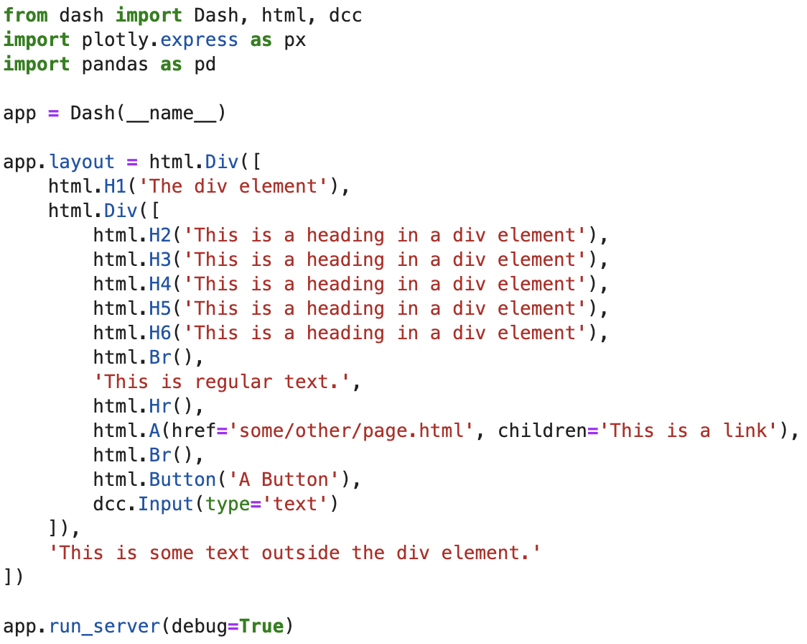
Dash Equivalent
Dash has api for all of the HTML elements in dash.html
Display only
Interactive elements are handled differently
Notes:
Show live view with inspect

Slide 10
Dash Core Components
Dash Core Components - the main set of interactive elements
Contained in dash.dcc package
Components for the most common dashboard functionality

Slide 11
Dash Core Components
Graph – Displays a Plotly chart
Dropdown – Allows single selection from a list
Input – takes user input by type:
text – any string
number – must be numeric
password – hides text
email – ensures email format
Checklist – List of checkboxes for multi-select
RadioItems – list of radio buttons for single-select
DatePickerSingle – choose a date
DatePickerRange – choose a start/end date
Slider – choose a value within a range
RangeSlider – choose a start and end value in a range
Tabs – Display tabbed layout
Tab – content for one tab

Slide 12
Dash DataTable
Displays a table similar to an Excel sheet
dash.dash_table.DataTable
Lots of built-in functionality:
Styling
Number Formatting
Conditional Formatting
Sorting/Filtering
Paging
Editing

Slide 13
Dash DAQ
Another set of components with more unique/specialized functionality
If desired, install using pip install dash_daq
Numeric value displays:
Gauge – like a speedometer
LEDDisplay – like a digital clock
Thermometer
GraduatedBar – like progress bar, but split into sections
Tank – like a single-bar chart
Numeric value inputs:
Knob – like a volume knob
Slider – alternative to dcc
ColorPicker – robust color picker control
ToggleSwitch – for selecting true/false

Slide 14
Dash Bootstrap Components
Another library of components
Highly customizable
Very flexible styling
Complex layout managers
We won’t cover this in class, but more info is available on their site
https://dash-bootstrap-components.opensource.faculty.ai

Slide 15
Component Layout
So far, we’ve just placed components using the default layout
Left-to-right, top-to-bottom
Dash supports any HTML layout methods
Countless methods available – too many to cover
We’ll cover one simple method: inline-block

Slide 16
Inline-block Layout
Similar to the default layout in that it goes left-right, top-bottom
However, gives you more control by specifying width
Use html.Div with style parameter being a dict:
display – must be ‘inline-block’
width – specify width by pixels or relative to parent
300px – 300 pixels
25% - 25% of the parent container

Slide 17
Starting the Server
Once the layout is set, call app.run_server() to start the server
It will listen on port 8050 by default
If using JupyterDash, use an extra parameter jupyter_mode:
external – default mode – just starts the server, you have to open a new browser or tab
inline – displays the dashboard inline in the Jupyter Notebook cell
jupyterlab – opens another Jupyter Lab tab to display it

Slide 18
Homework – Simple Gas Mileage Dashboard
Revisit the gas mileage program from the 101 class to build a dashboard
Use the first two charts built in session 9:
Bar Chart comparing the mileage of the top 20 cars
Line Chart showing the distance of each trip for the car with the most trips
Add a DataTable to display the average speed and mileage using the data written to Excel in session 8
Lay out the two charts side-by-side at top, with the DataTable below taking the full width

