Slide 1
Intermediate Data Science Programming
5. Plotly - Advanced Plots & Subplots

Slide 2
Axis Customization
Plotly does a “best guess” for axis settings based on the data:
  Titles
  Tick values and labels
  Range
  Grid lines
All of these settings can be overridden
Set axis settings using:
  update_xaxis()
  update_yaxis()

Slide 3
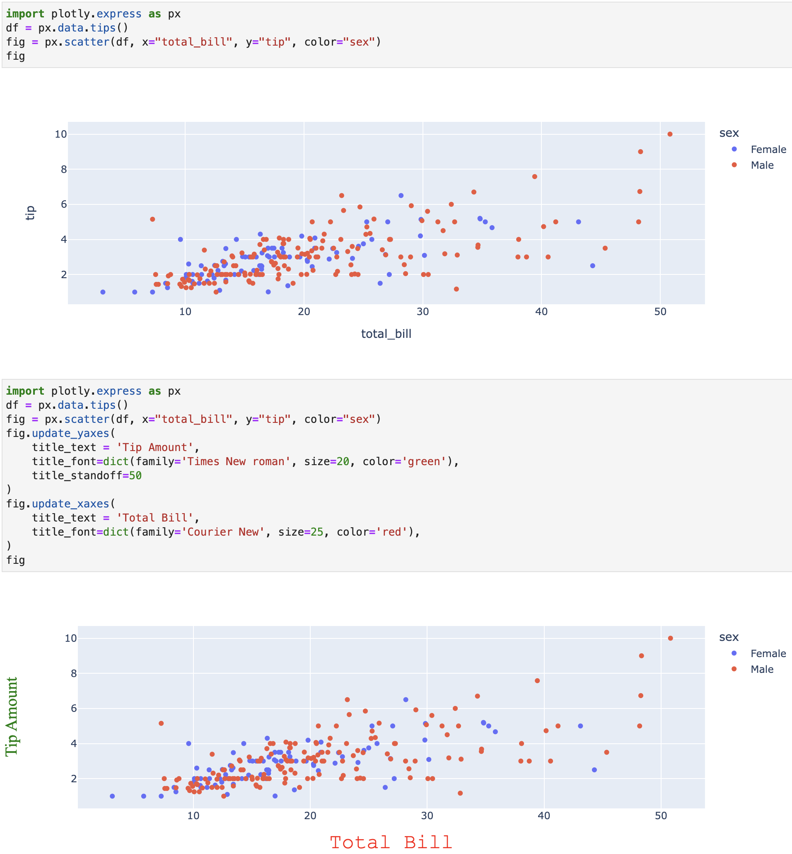
Axis Titles
Default is the name of the data field
Set the axis titles using title_text
Set the font using title_font
  Takes a dict of:
    family – Name of the font
    size
    color
Set position using title_standoff

Slide 4
Ticks
Ticks are the points along each axis that are labeled
Many attributes can be configured:
Specify tick values:
  Start value and space between
  Enumerated values
Tick Labels:
  Text
  Position
  Font
  Rotation
  Skipping
Marks
  Show/hide marks
  Position
  Size
  Color
Minor marks

Slide 5
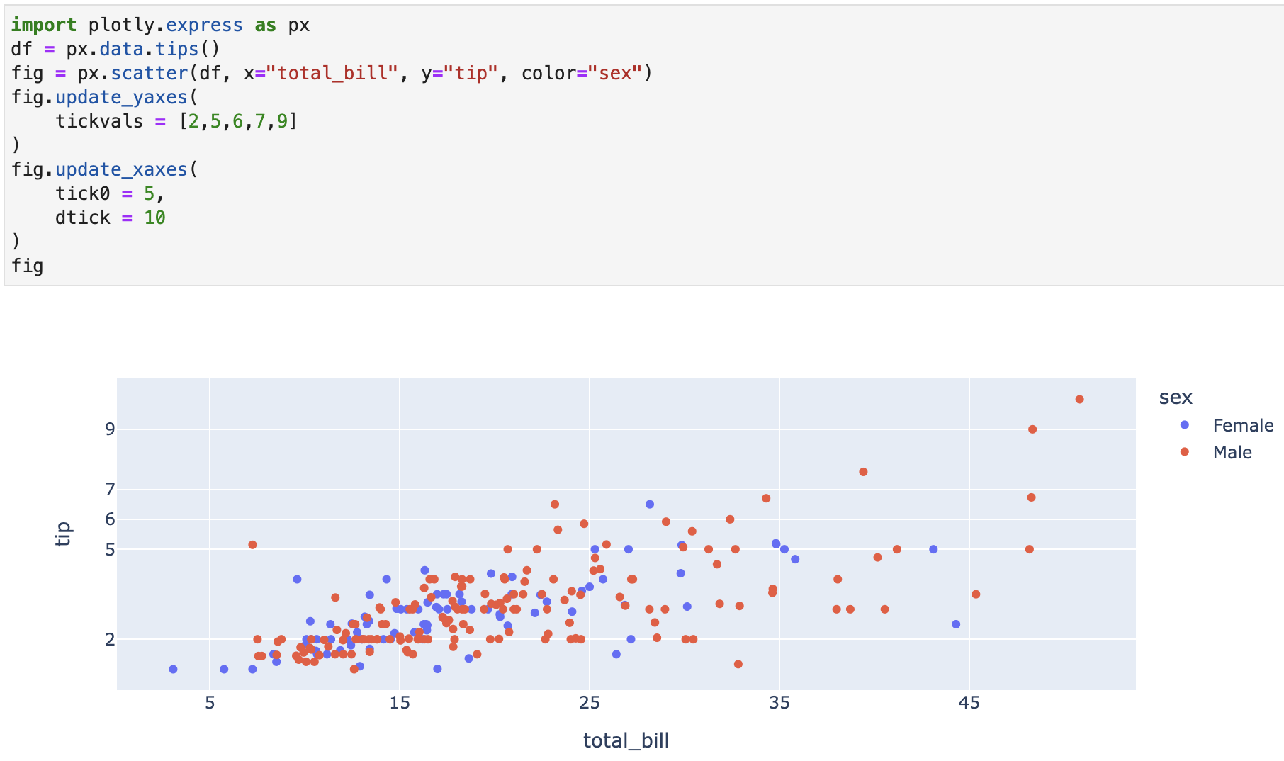
Tick Values
Start and spacing
  tick0 – start value
  dtick – space between
Enumerated Values
  tickvals

Slide 6
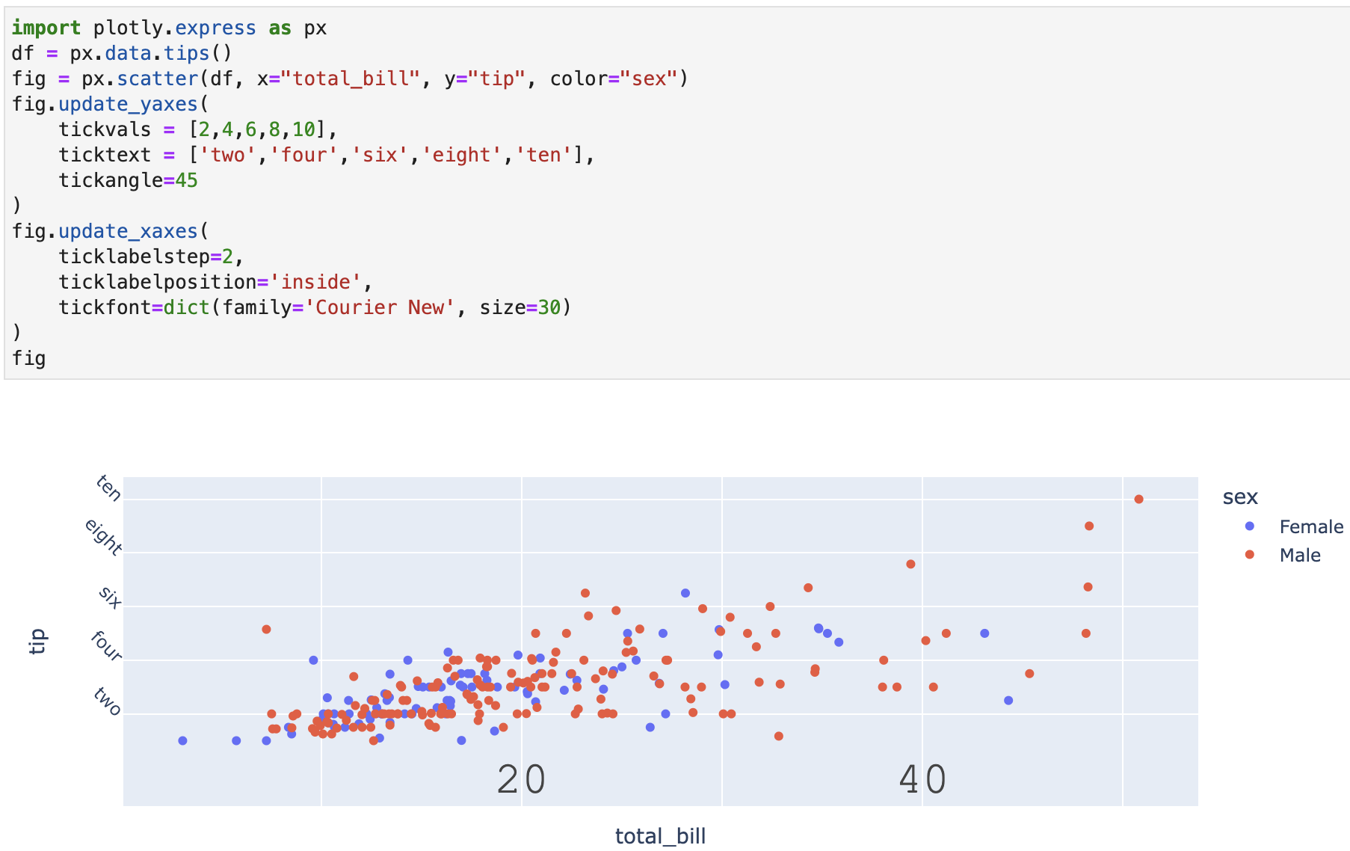
Tick Labels
ticktext – override tick label text
  Note: only works with tickvals
tickangle - angle
ticklabelposition – position
tickfont – dict, same as titles
ticklabelstep – skip labels

Slide 7
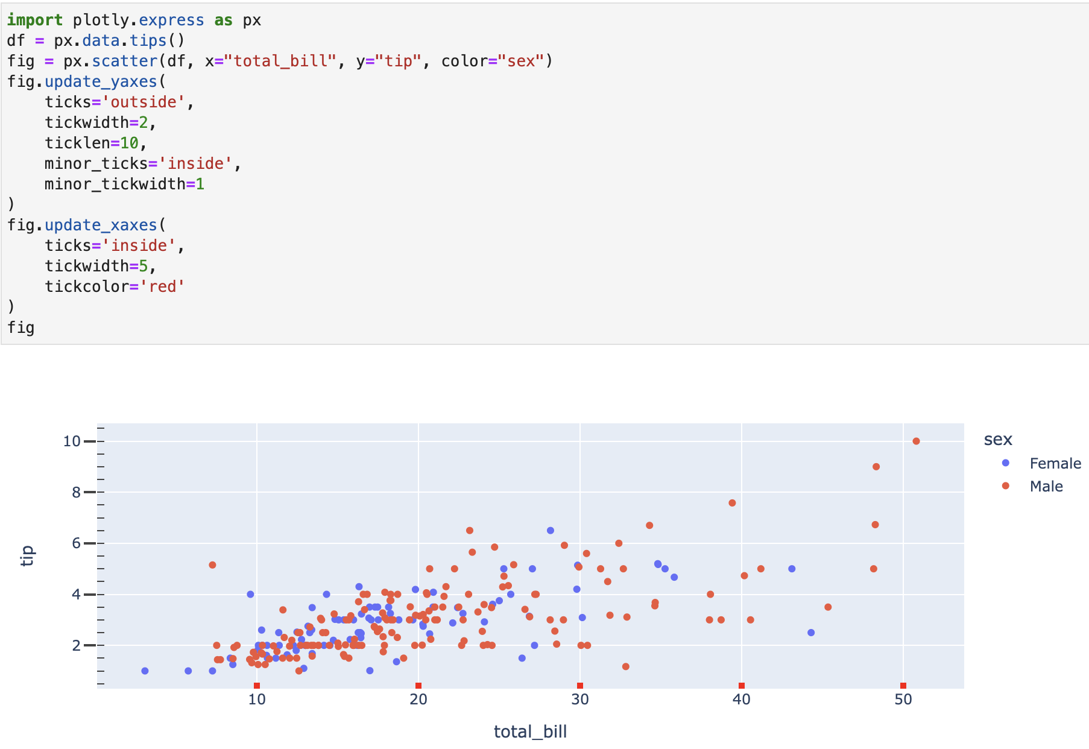
Tick Marks
ticks – show ticks at position
Size
  tickwidth
  ticklen
tickcolor
minor_* – use with any of the above settings to show minor ticks

Slide 8
Axis Range
Set the initial range using range
  Can reverse the axis by swapping the range values
Pan/zoom actually changes the range. This can be prevented using fixedrange
Keep same aspect ratio using
  scaleanchor
  scaleratio
Notes:
Show demo of pan/zoom – cell 6/7

Slide 9
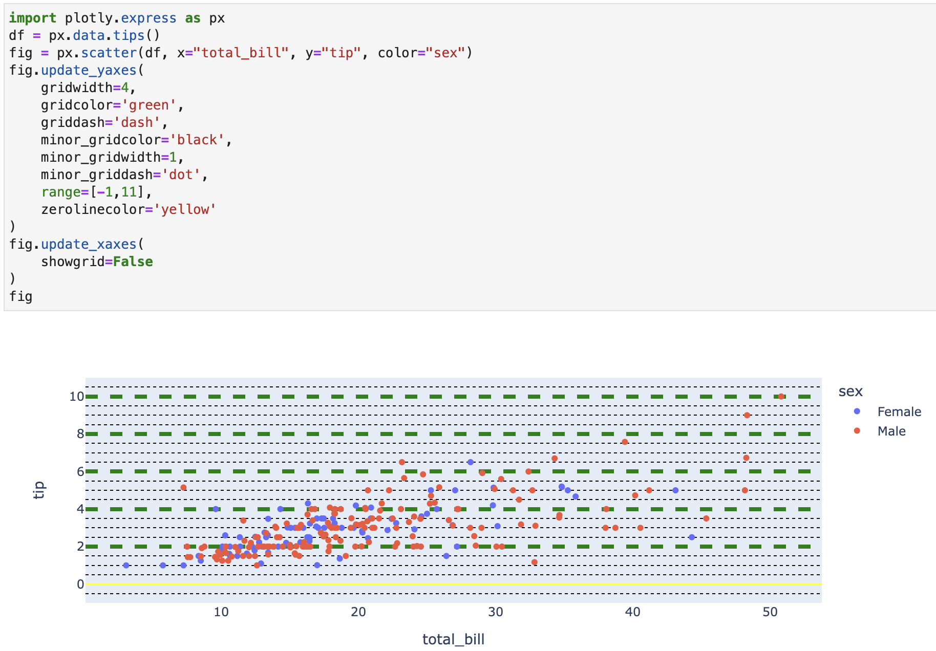
Grid Lines
showgrid – show/hide grid lines
gridwidth
gridcolor
griddash – dashed lines
minor_* - use with any of the above for minor gridlines
Zero line settings
  zerolinewidth
  zerolinecolor

Slide 10
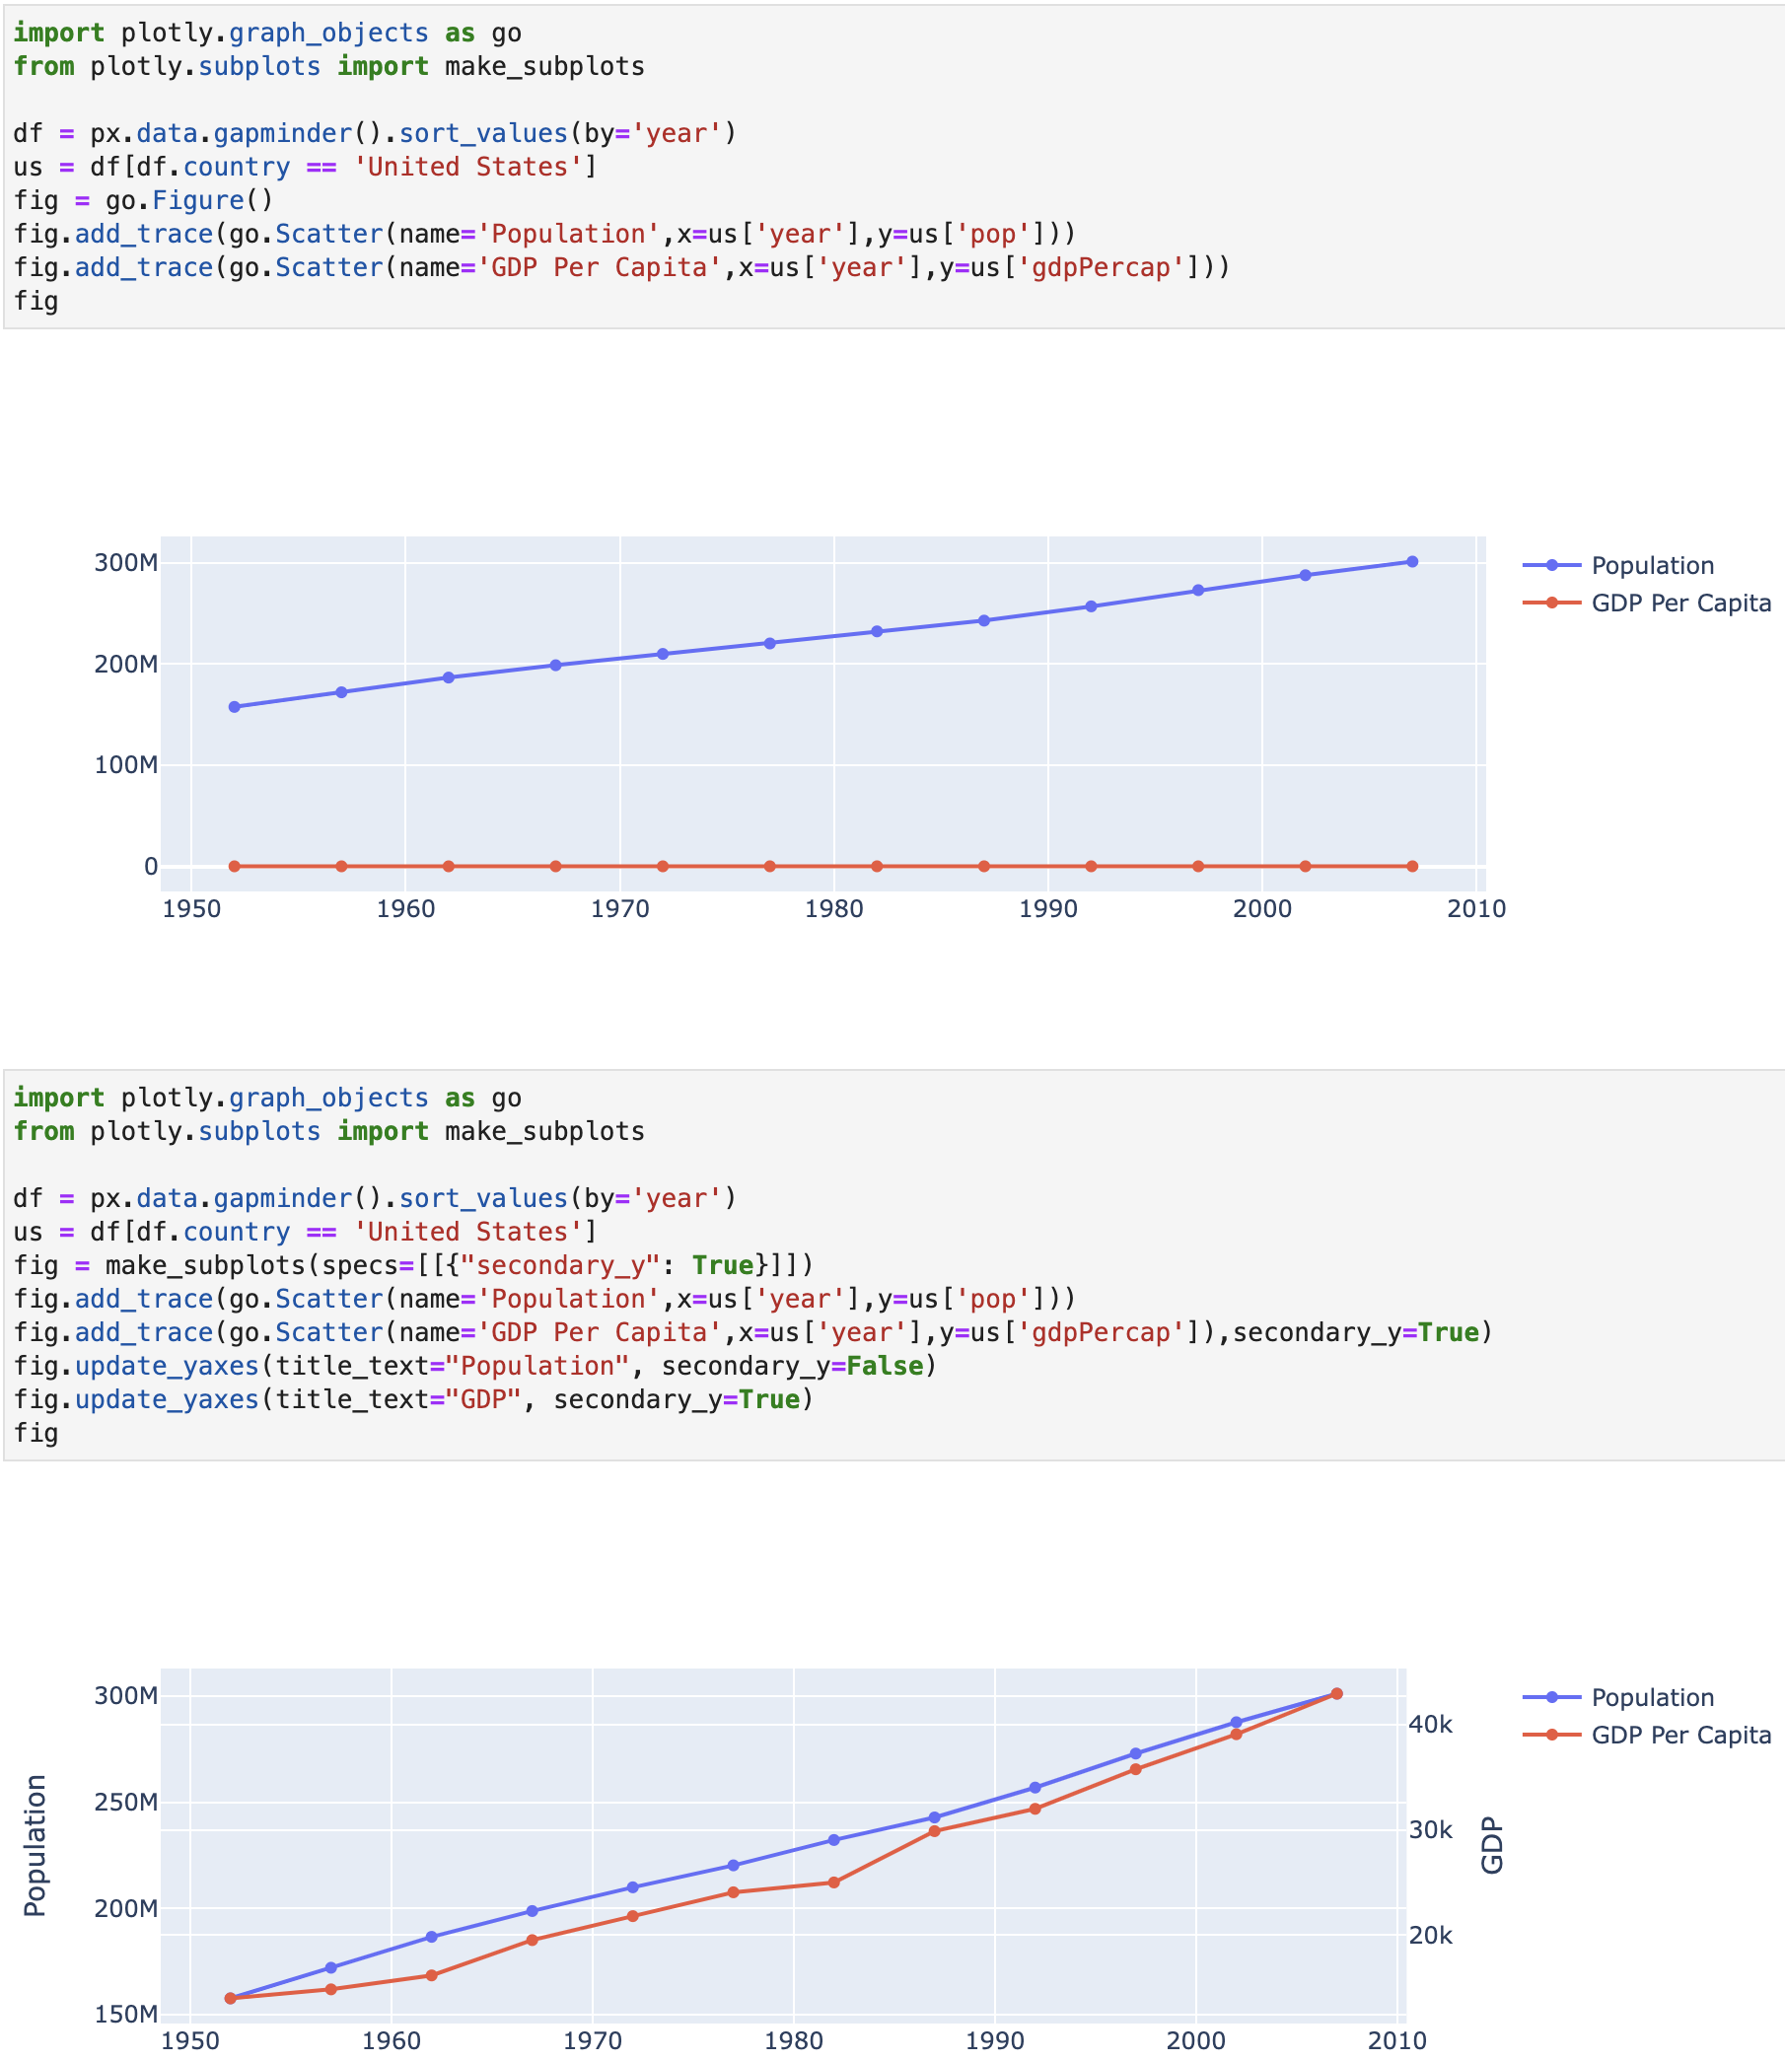
Multiple Axes
When plotting data with different ranges on one chart, Plotly can use multiple axis ranges
Create figure using a special case of make_subplots
Then use secondary_y to specify which traces go with the second axis

Slide 11
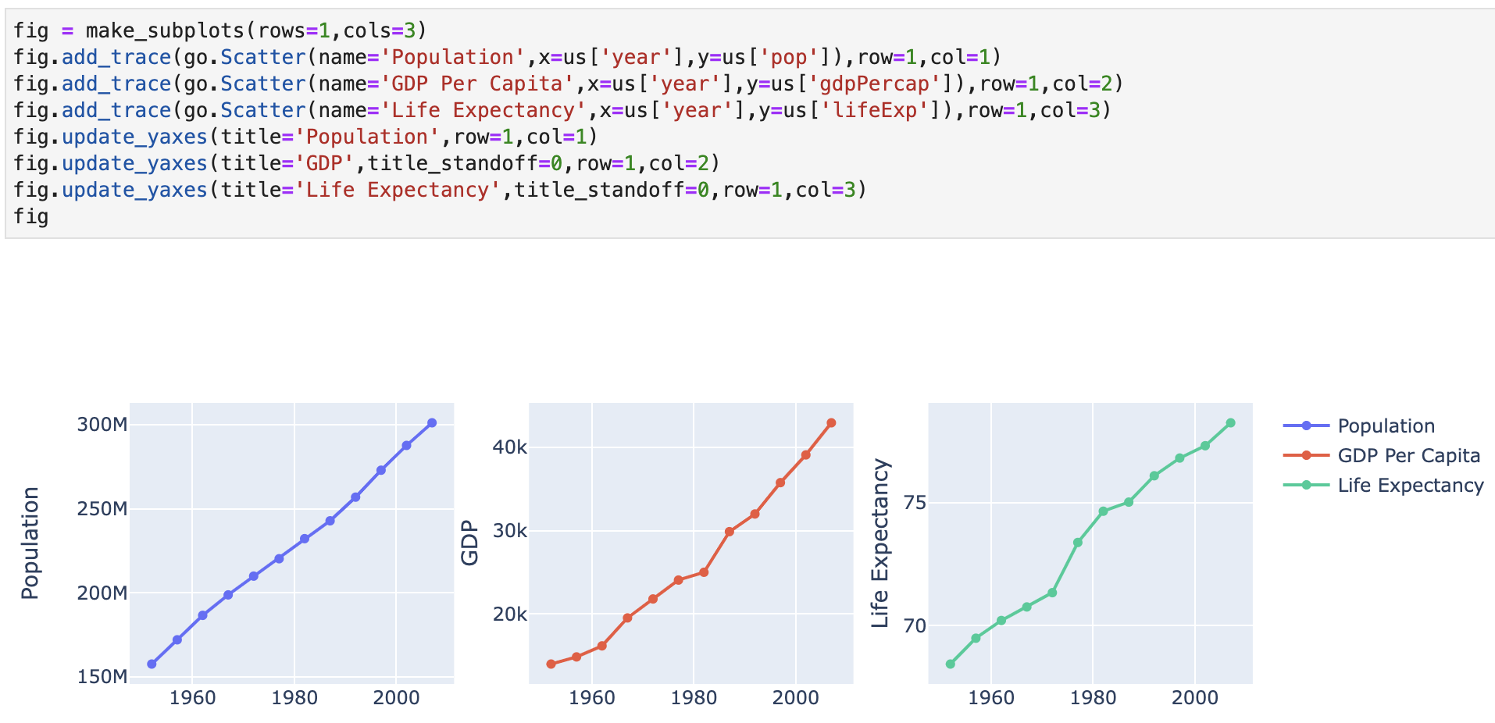
Subplots
make_subplots main use is for making subplots – multiple charts in one in a grid layout
  rows – the number of rows
  cols – the number of columns
When adding traces, use row and col to specify where the trace goes in the grid
row and col also work in update_*axes()

Slide 12
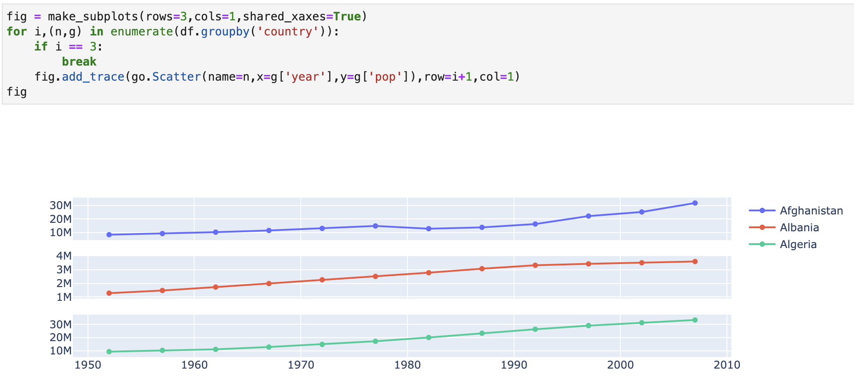
Subplots – shared axes
Subplots can share axes using shared_*axes in make_subplots
It will remove the axis labels on all but one chart to save space

Slide 13
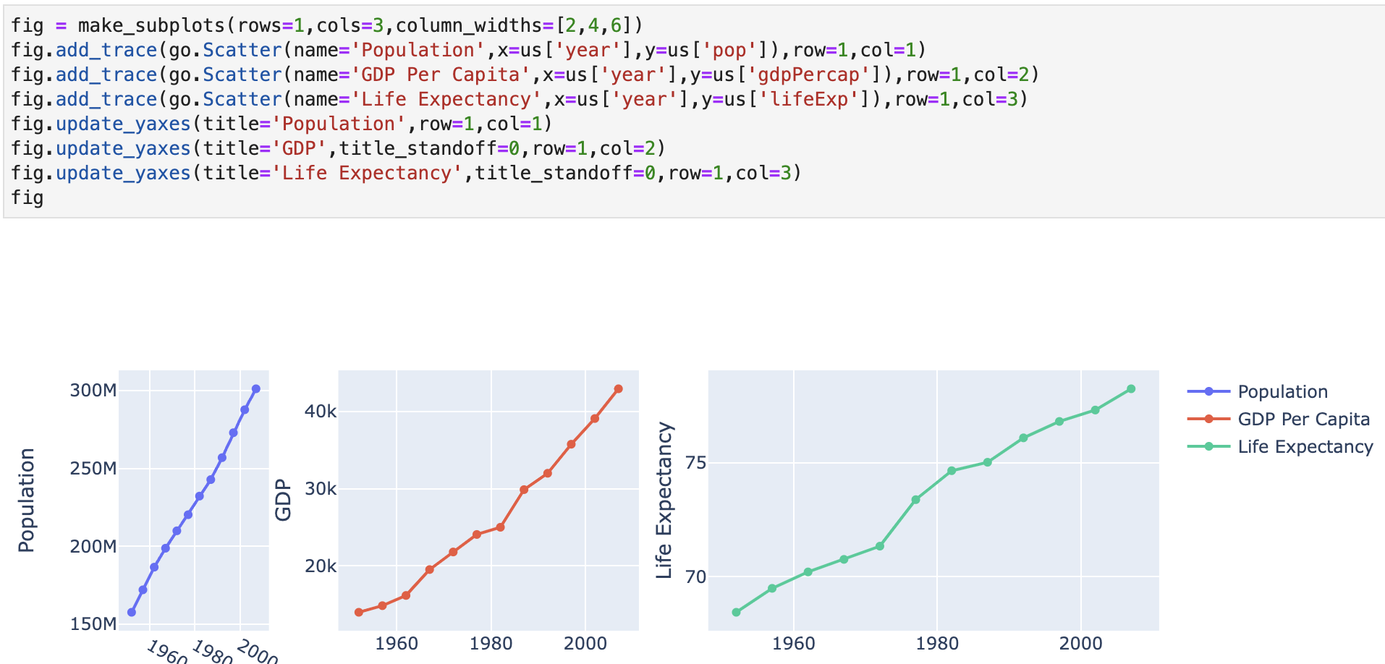
Subplots – row/column size
Each row and column can have a different size
In make_subplots:
  row_heights
  column_widths
Pass a list of numbers to set the relative sizes

Slide 14
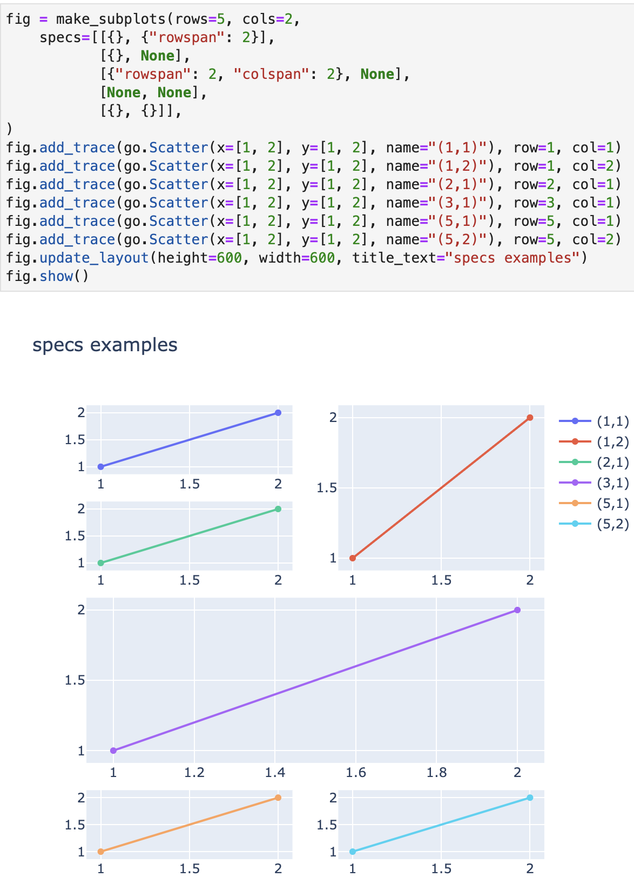
Subplots - layout
The grid layout is flexible
Use specs parameter of make_subplots to specify row and column spanning
Takes a nested list that matches the grid
Use a dict with rowspan or colspan
1
2
1
2
3
4
5

Slide 15
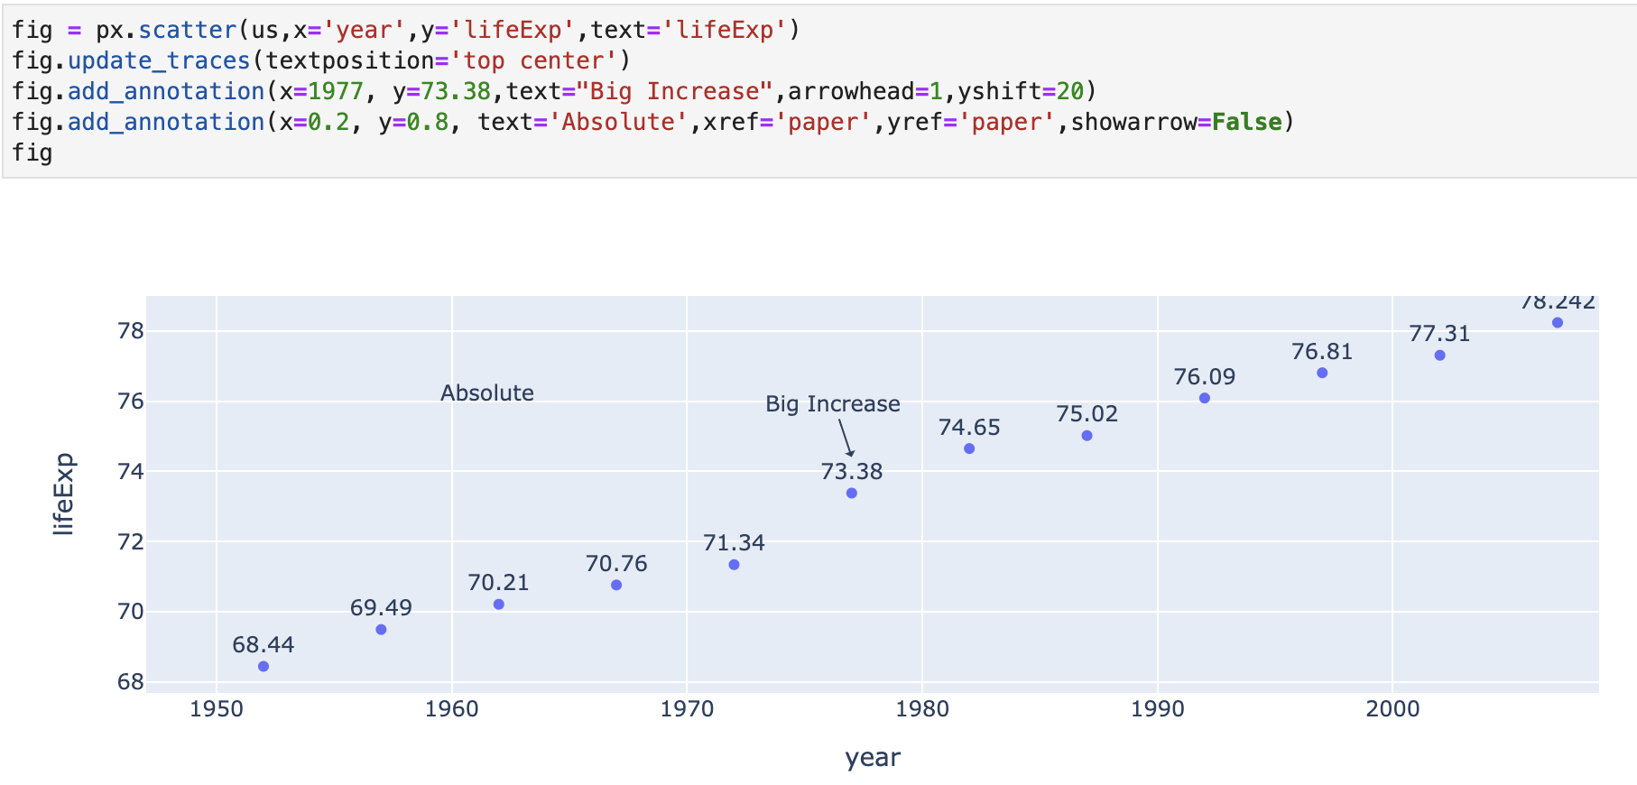
Text
Text labels can be added to charts in two ways:
  Scatter trace with text parameter for data to use
    Positions by data coordinates
  figure.add_annotation()
    Absolute positioning:
      Set x and y to number between 0 and 1
      Set xref and yref to ‘paper’
      Note: absolute position does not move with pan/zoom
    Can optionally display an arrow

Slide 16
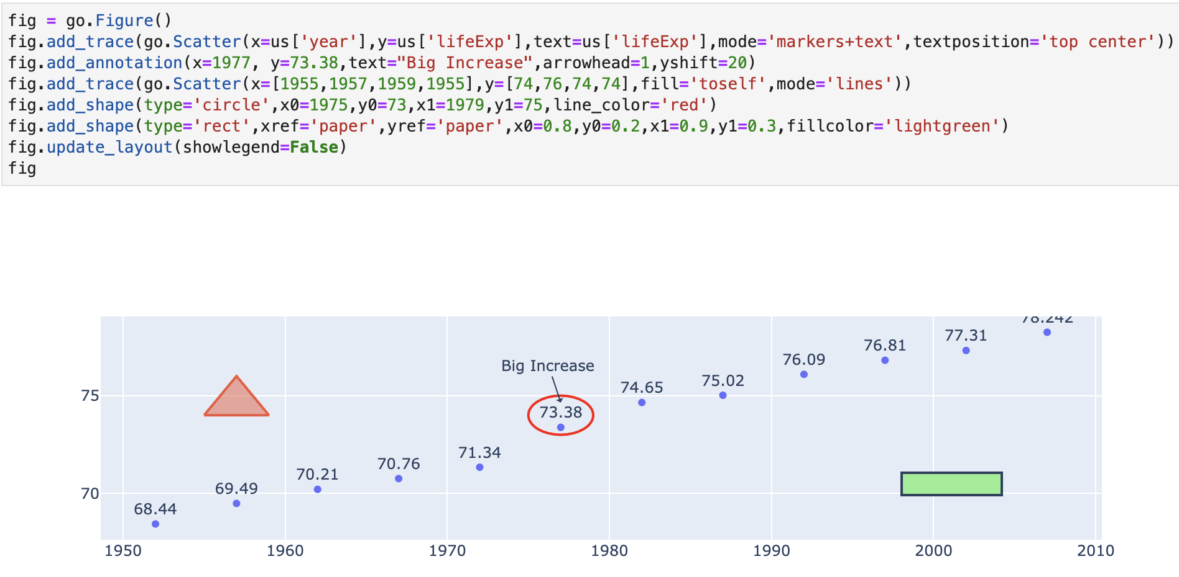
Shapes
Shapes can be drawn, also in two ways similar to text:
  Scatter plot with lines and fill=‘toself’
    Positions by data coordinates
  figure.add_shape()
    Can position by data cords or absolute
      Again, absolute does not move with pan/zoom

Slide 17
Animation
Charts can be animated to show changes over time
Plotly express can animate based on the data
  animation_frame – the field to use for the ’elapsed time’
  animation_group – how to group the data, e.g. determines which rows from each animation frame go together
    Plotly can “guess” this, but sometimes fails
Graph Objects animates based on a list of Frames
  You need to set up each frame yourself
Notes:
Show demos

Slide 18
Homework
Again, no assigned homework this session
Instead, just think about:
  How these topics can be applied to your projects
  If your projects have any other needs not covered so far
No need to report in class, however contact me for a call to discuss

