Slide 1
Intermediate Data Science Programming
4. Pandas – Advanced Processing

Slide 2
Reading From Database
Pandas can create DataFrames from databases using read_sql()
Two options:
  Read a whole table
  Execute a statement
    Any SQL statement that produces a single result set
    E.g. limit the rows, columns, or join multiple tables
Extra requirements:
  sqlalchemy – python library for database connection/management
  Database-specific libraries/drivers

Slide 3
Database-Specific Configuration
mysql – mysqlclient
Microsoft SQL Server – 2 options:
  If on Windows and ODBC data source is available – pyodbc
    Can reference the DSN so not all of the connection info is needed inside python
  If not Windows, or if no ODBC data source – pymssql
    Will need to enter all connection info into python
Oracle – cx_oracle
Others:
  See https://docs.sqlalchemy.org/en/14/dialects/index.html
  Contact me for coaching call to help set up

Slide 4
Getting Database Data
Done in 2 steps:
  Create an engine
    Takes a connection string – different for each database
    Maintains the connection to the database
    One engine needed per database – can be reused for multiple reads/writes
  Call pandas.read_sql(‘table_or_sql’,engine)
    First parameter is the table name or sql query string
    Pass the engine as the second parameter
    If the table is not in the default schema, use:
      pandas.read_sql_table(‘table’,engine,schema=‘schema’)
Notes:
Demo connecting to mysql, mssql
Switch to windows vm to show mssql via odbc
Explain not showing oracle, but can help if you need it

Slide 5
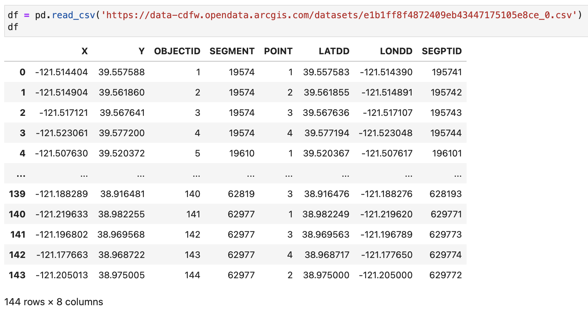
Reading From Web Services
Any Pandas read method that takes a file, can also read from a web URL:
  read_csv
  read_excel
  read_json
  read_xml
  read_html
  …

Slide 6
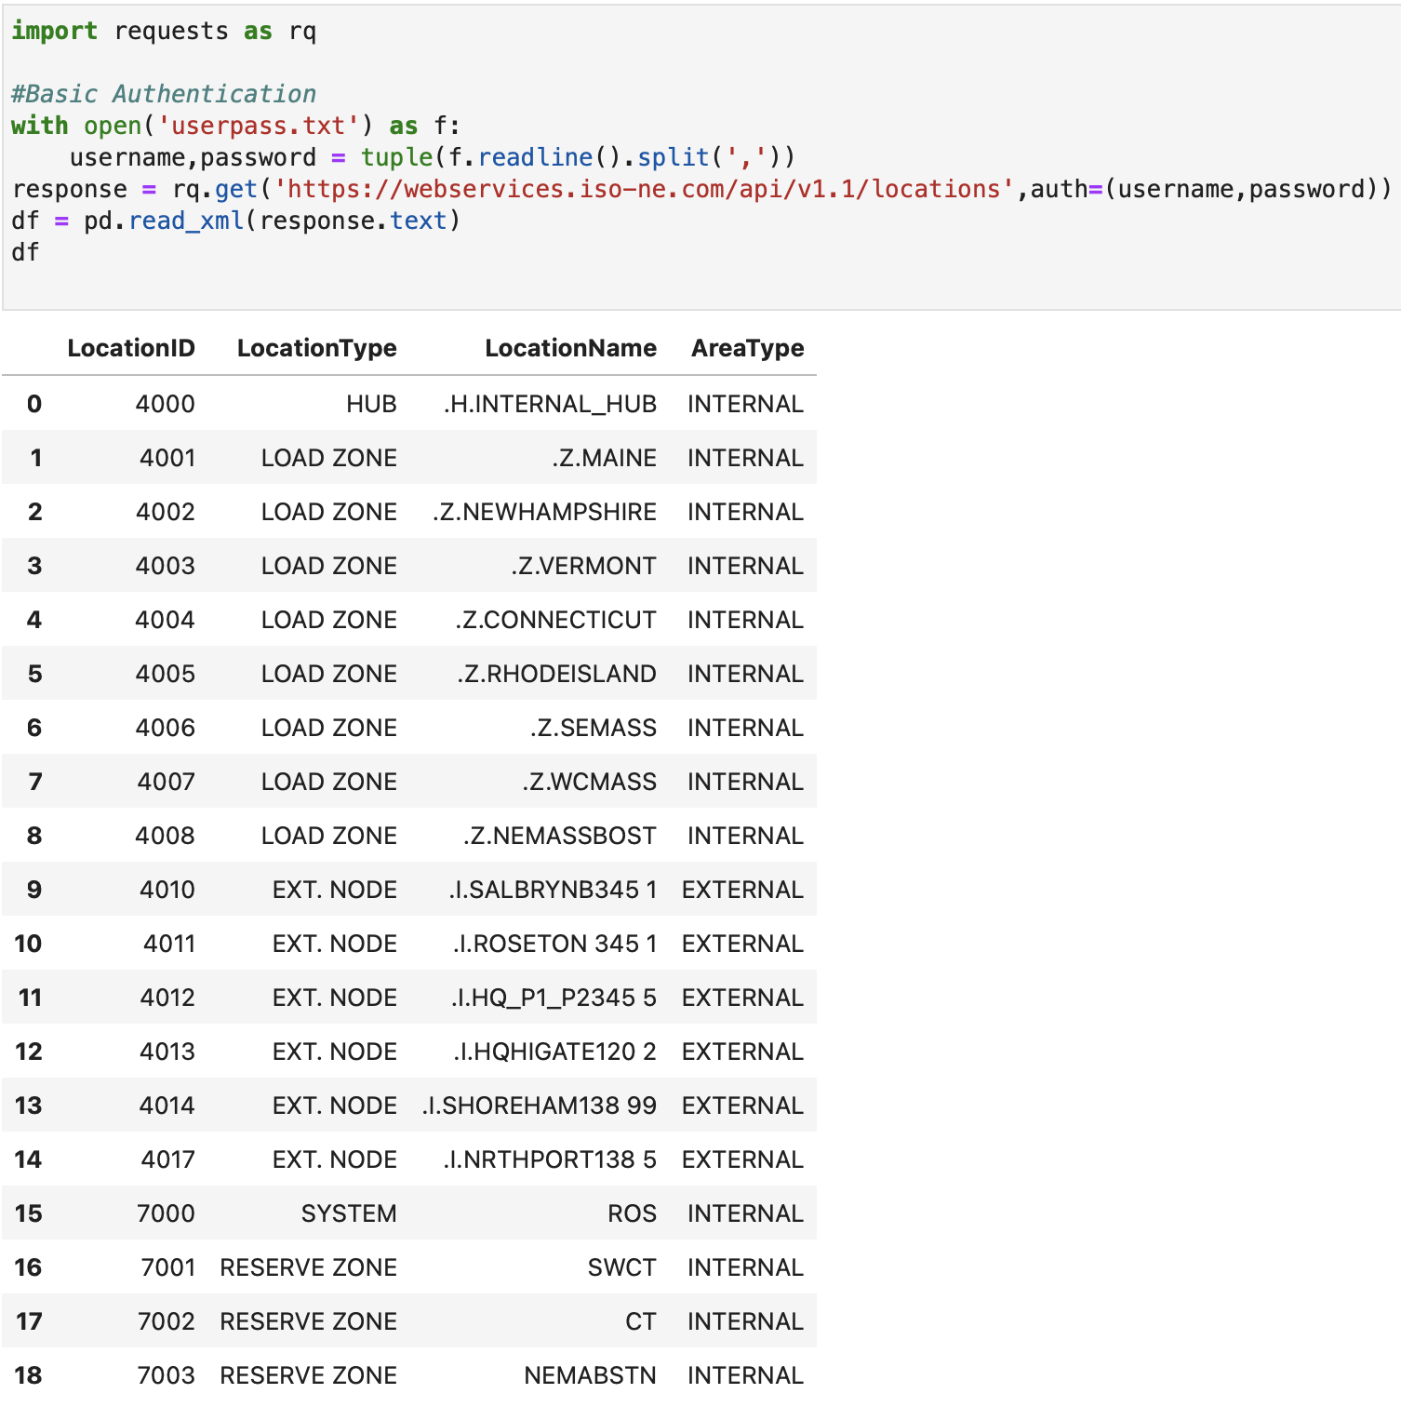
Web Services Authentication
Some web services require login
To do that, use another python library: requests
Use requests.get() and pass the auth parameter to provide authentication
get() returns a response
Then pass the data to the appropriate pandas read method using response.text

Slide 7
Web Services Authentication
Basic Authentication
  Just pass tuple of user and password
Digest Authentication – encrypts user/pass
  Use requests.auth.HTTPDigestAuth with user and password
Other authentication methods:
  OAuth1
  OAuth2/OpenID Connect
  Kerberos
  Other/Custom

Slide 8
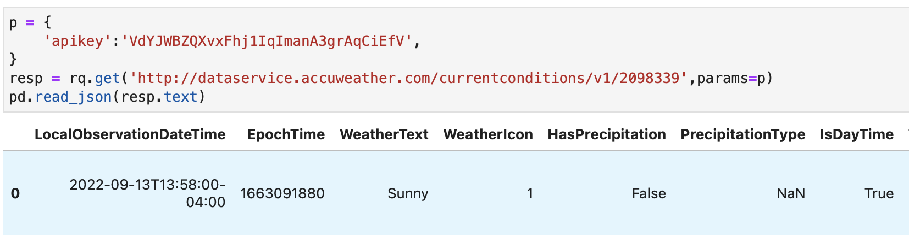
Web Services Parameters
Some web services require extra information
  API key
  Content-Type
  Data-related parameters
These can also be passed into requests
  If using query parameters, pass dict into params
  If using HTTP headers, pass dict into headers

Slide 9
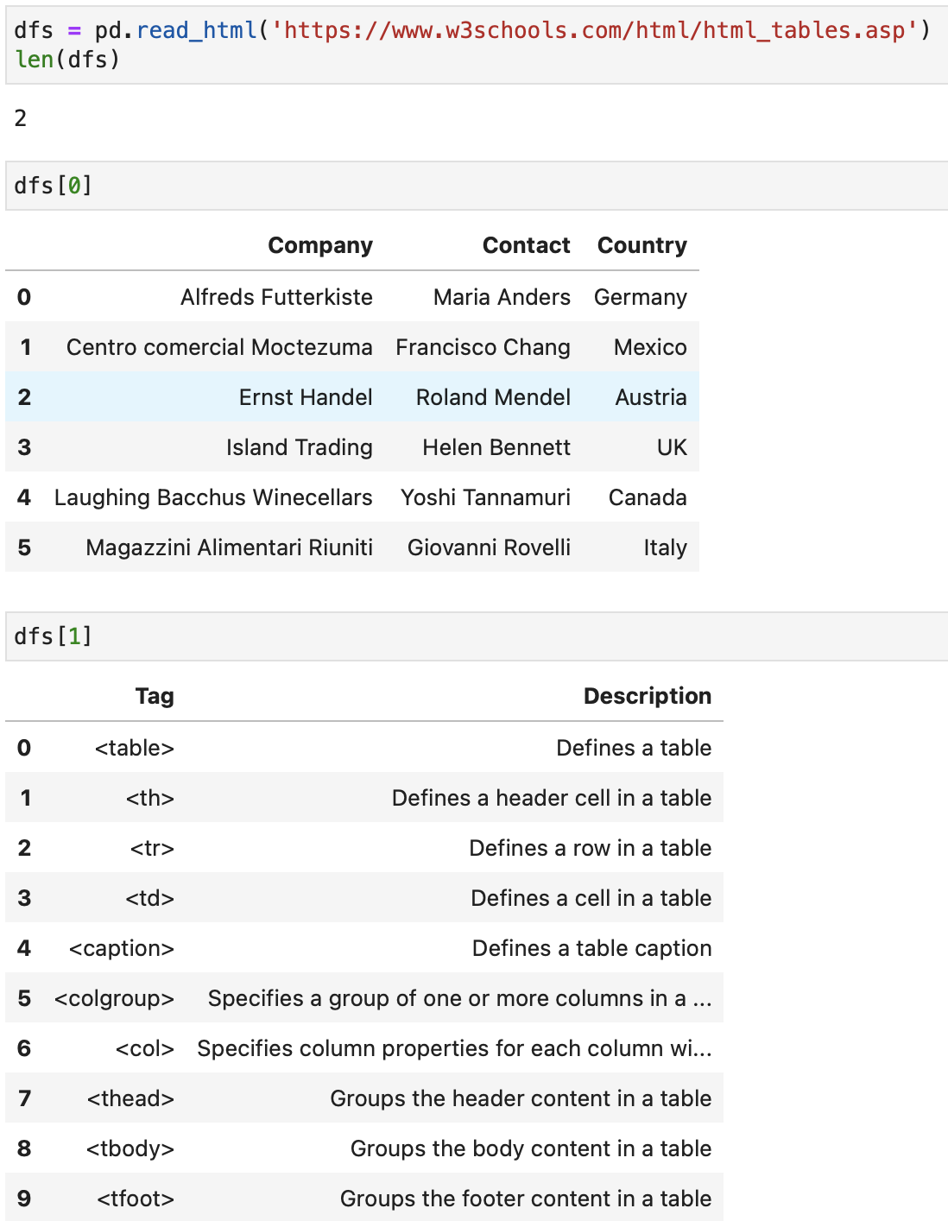
Reading HTML tables
Pandas can read a website and extract all the tables into DataFrames using read_html()
This can be error-prone, by the nature of HTML
There are a number of options to work around these errors
Notes:
https://www.w3schools.com/html/html_tables.asp

Slide 10
Executing Functions
Sometimes what you want to do is not covered by built-in Pandas functionality
You can write a function and run it over a DataFrame
  apply() – runs the function by axis (either rows or columns)
    Input is Series – return can be Series or scalar item
  applymap() – runs the function by element
    Both input and return are scalar items
    If using Pandas 2.1+ this has been renamed to just map()
  agg() – runs an aggregate-type function by axis
    Input is Series – return is scalar item (e.g. sum adds all items and returns the total)
  transform() – runs one or more functions by axis
    Input is Series – return must be series of same length
Notes:
Demo these
Apply – use gapminder. Suppose the census count was 1% too low for 1967. apply a function to fix it
also show using lambda instead of regular function
Applymap – random dataframe – if item > 5, convert to negative
Agg – random dataframe – return count of items > 5
Transform – gapminder – show multiple function use

Slide 11
Executing Functions
Functions can also be run on Series
  apply() – runs on each item in the series
    Input is scalar, return can be scalar or Series
  map() – also runs on each item, however also can take a dict instead of a function, replaces each value with the corresponding dict item
  agg() – runs on the whole series
    Input is the Series, return is scalar
  transform() - runs on Series, again can optionally run more than one
    Both input and return are Series
    Return must be same length as input
Notes:
Demo these as well
Apply – gapminder age – make the minimum 35
also show returning a series to produce a dataframe
Map – random data – show using dict to replace values
Agg – same random data – count entries < 5
Transform – same random data – multiple functions

Slide 12
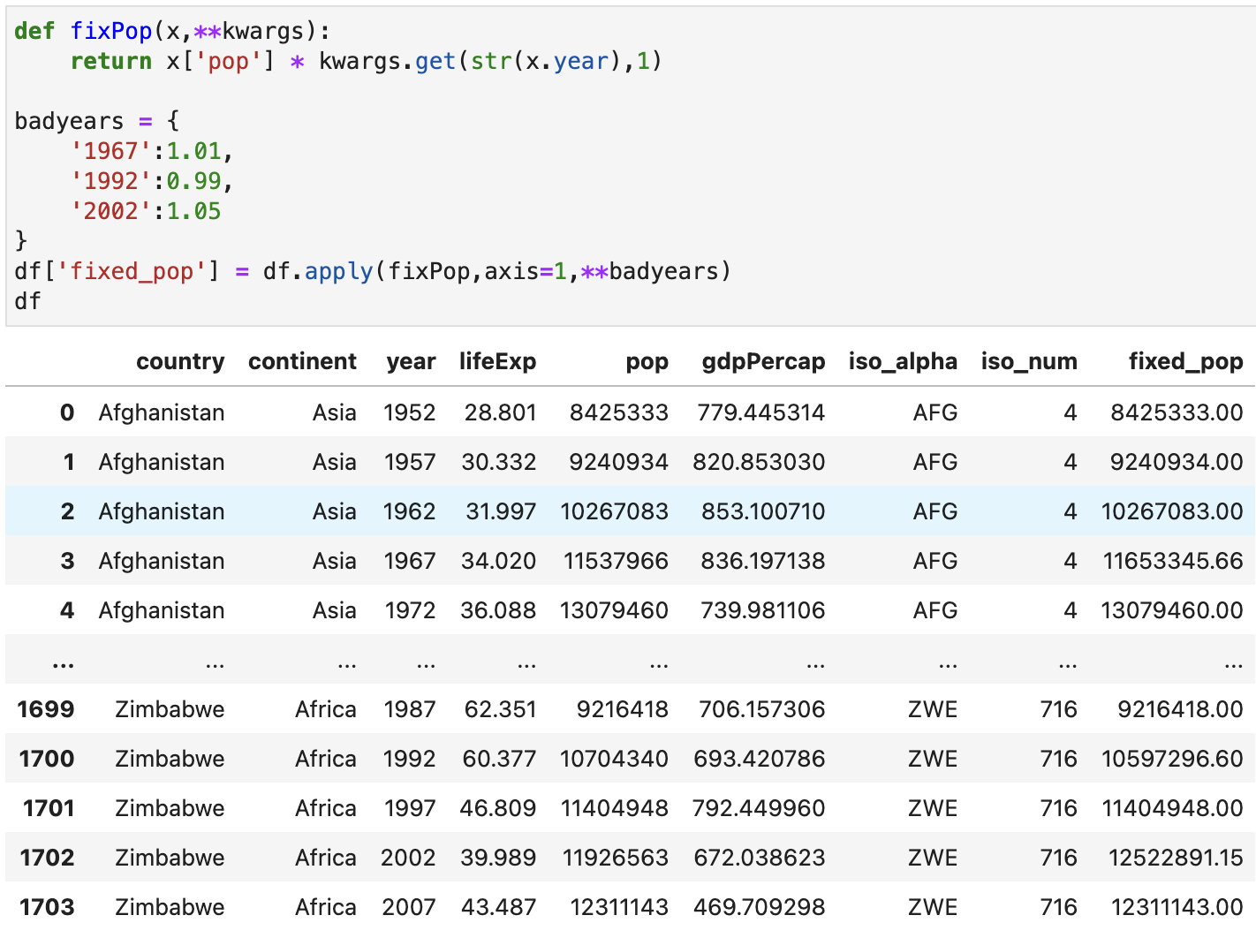
Extra Parameters
Functions can take extra parameters using args and kwargs
Works the same as with regular functions
Pass them into the apply function, they are forwarded to your function

Slide 13
Functions with Groups
Functions can also be run with groupby()
Each group is a DataFrame that works the same as regular
The results are combined back into one DataFrame or Series
Can also use args/kwargs with groups
Notes:
Demo – gapminder – count of years where life expectancy <40, by continent – function returns scalar, apply returns series
also show function returns series, apply returns dataframe
Gapminder – show using args to pass a different adjustment factor per group

Slide 14
Resampling
Pandas can resample time-based data to different frequencies
Can downsample and upsample
  Downsample – convert from high to low frequency
  Upsample - convert from low to high frequency
Frequency options: https://pandas.pydata.org/docs/user_guide/timeseries.html#timeseries-offset-aliases
Can also use functions, similar to groupby
Notes:
Demo – generate data for taking readings every second – resample to per minute by mean
Take results and resample back to per second by interpolating
Again by filling
Use apply to count values <5 per 5-minute intervals

Slide 15
Very Large Datasets
Most work with Pandas involves reading the entire dataset into memory, then performing the operations on it
For very large datasets, it may not be possible to read all the data at once
One solution is chunking – splitting the data into manageable sized chunks and processing each sequentially
  Some pandas read methods can do this for you via the chunksize parameter
    read_csv, read_sql
  Others require you to split the data yourself
  Only works when data in one chunk does not depend on other chunks
Notes:
Demo – write out resample data to csv and reread it using chunking
Read database using chunking as well

Slide 16
Very Large Datasets
Another solution is a python library called dask
  API is the same as Pandas, you can use Dask DataFrames just like regular Pandas DataFrames
  However, internally it breaks very large datasets up into partitions, and processes them separately
  Can handle some dependencies between partitions
    Can significantly slow processing, and some dependencies cannot be handled
  Can take it a step further and process partitions in parallel using multiple processes, or even multiple machines in a cluster
We won’t cover Dask in class, contact me if you have a very large dataset to be processed

Slide 17
Homework
No assigned homework this session
Instead, just think about:
  How these topics can be applied to your projects
  If your projects have any other needs not covered so far
No need to report in class, however contact me for a call to discuss

