Slide 1
Intermediate Data Science Programming
1. Review of beginner concepts, Intro to intermediate topics, Environment setup

Slide 2
Beginner Review
We covered a lot of topics in the beginner course:
Environment Setup
  Installing libraries and tools
  Interactive vs. Non-interactive
  Jupyter Notebook
Syntax
  Expressions, Keywords, Operators
  Literals, Variables
  Slicing: [start:end:step]
Primitive types:
  str, int, float, bool
Complex types:
  list, tuple, set, dict
String formatting
  %, .format(), f-strings
Functions and Methods
  Code completion
Flow control
  Normal
  Conditional
    if, elif, else
  Loop
    while, for
  Error
    try, except, else, finally
Modules
  Installing, importing, using
Pandas – tabular data processing
Plotly – charting

Slide 3
201 - Intermediate
Review of beginner concepts, Intro to intermediate topics, Environment setup
Writing Functions & Classes
Multiple Files: Modules & Packages
Pandas – advanced processing
Plotly – advanced plots & subplots
Dash - Intro and simple layouts
Dash - Callbacks and Interactivity
Converting notebooks to standalone programs
Running on schedule or as a continuous service
Expand upon the beginner course to learn higher level programming concepts like functions, classes, and multi-file programs. Perform advanced processing and analysis over DataFrames, and design more complex visualizations. Layout multiple visualizations into dashboards and turn interactive notebooks into standalone programs that can run continuously or on schedule.

Slide 4
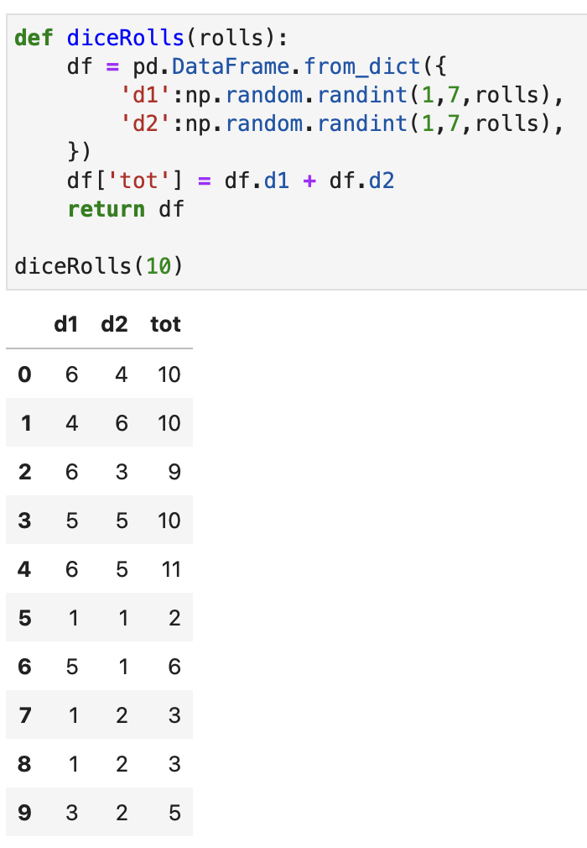
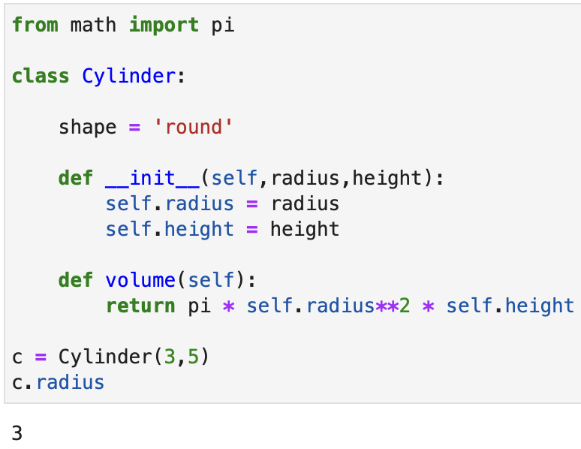
Functions and Classes
Function - A named piece of code that can be run using ()
Class – a grouping of fields and methods encapsulated into a new type

Slide 5
Multiple Files: Modules and Packages
module - a grouping of python code, external to your program, that can be imported and used
  Any python file (*.py) can be a module
  Import using filename
package – a grouping of modules into a directory
  __init__.py – File must exist, to tell Python this is a package
  One or more other python files
  Import using directory.filename

Slide 6
Advanced Pandas
Using functions to perform more complex operations over DataFrames
More complex select, subset, group, combine operations
Reading from and writing to many locations and formats

Slide 7
Advanced Plotly
Building more complex charts
Using subplots – multiple charts in one
Customize layout and formatting

Slide 8
Dash
Dash is a companion tool to plotly that enables building of interactive dashboards
Launches in its own window/tab
Lays out multiple Plotly charts along with other input and output controls

Slide 9
Converting Notebooks to true Python programs
Notebooks must be run interactively using Jupyter
Jupyter has tools to convert a notebook into a regular python script
Those scripts can then be run as standalone programs
  Run on schedule to do periodic processing
  Run continuously to provide a dashboard as a website

Slide 10
New Tool - Jupyter Lab
Jupyter Notebook
Jupyter Lab
Single file at a time
Simpler interface
Suited for beginners and smaller projects
Multiple files at once
Full-featured IDE
Runs notebooks as-is
Many other tools built-in
More tools installable as plugins
Suited for larger, more complex projects

Slide 11
Install Jupyter Lab
In Anaconda Navigator:
  Select Home tab
  Make sure ds2023 environment is selected
  Click Install below Jupyter Lab

Slide 12
Install Libraries
In Anaconda Navigator:
  Switch to Environments tab
  Select ds2023 environment
  Click the green triangle button and open Terminal
  In the terminal, type:
    pip install dash nodejs

Slide 13
Install Node.js
Go to https://nodejs.org
It should detect your OS and display a button for the installer download
  The latest LTS version:
  If not – select the Downloads menu and then select the correct one for your system
Download and run the installer
  If you get a step to install Tools for Native Modules, don’t check the checkbox
In the terminal launched from Anaconda Navigator, run the command: node –v
  If it shows the version number, go to the next step
  If it gives an error, exit the terminal and restart Anaconda Navigator and try again
  If is still errors, contact me to set up a coaching call

Slide 14
Rebuild Jupyter Lab
jupyter-dash installs plugins that require Jupyter Lab to be rebuilt
Continuing in the terminal, run: jupyter lab build
On some systems this can fail. If so, try running it a second time.
If it still fails, contact me to set up a coaching call

Slide 15
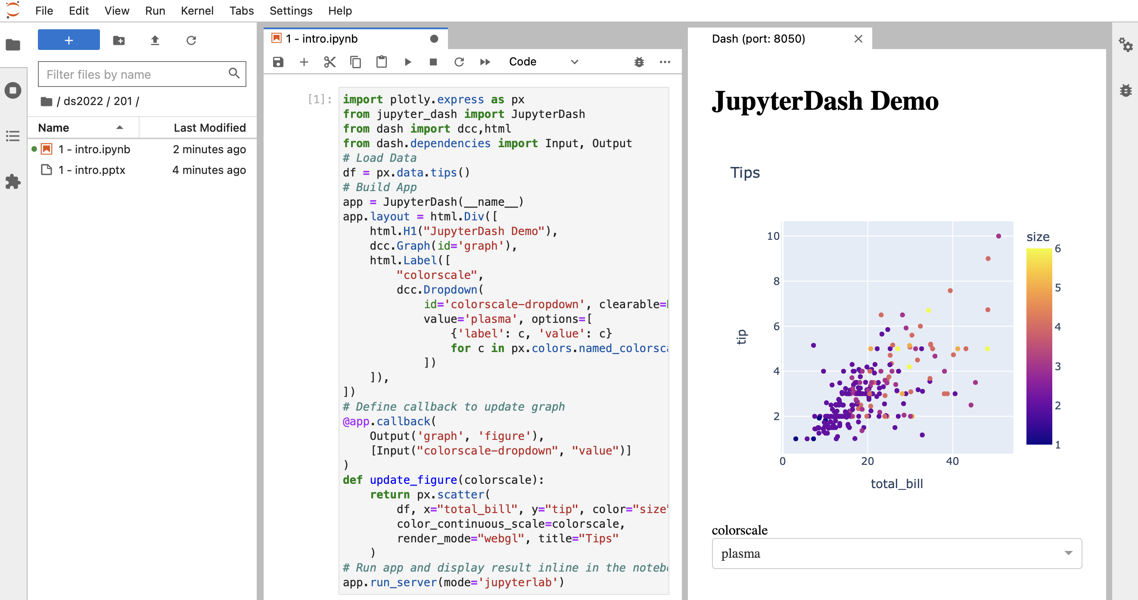
Homework: Run Example Code
Login to the class website
Find entry for this class:
  202 - 1. Review of beginner concepts, Environment setup/checkup, Intro to intermediate topics
Download the example code:
  1 - intro.ipynb
Open it in Jupyter Lab and Run
It should run and launch another tab with a dashboard
  If not, contact me for help setting up your system

