Slide 1
Beginner Data Science Programming
7. Pandas
Read, Display, and Write tabular data

Slide 2
Pandas
Community python library for data analysis and manipulation
Provides:
Data structures for tabular data
Operations to analyze, manipulate, combine, and split data
Tools to read and write data using a variety of formats
Very high performance
Supported by many other libraries/tools

Slide 3
DataFrame
Index
Series
Data structure for tabular data – columns and rows
Similar to spreadsheet, database table, .csv
Columns are represented by Series
Rows are referenced by Index
Can be created in many ways

Slide 4
Creating a Series
Pass in a list, array, other iterable
Optionally give it a name

Slide 5
Creating a DataFrame
Using a 2-dimentional array
Columns are numbered 0-n by default
Optionally pass in names using columns

Slide 6
Creating a DataFrame
Using multiple Series
Pass in a dict with column names as keys, and the series as values

Slide 7
Creating a DataFrame
Using from_dict()
Can skip creating series and create the dataframe directly from a dict of lists
If your data is arranged by rows, use orient=‘index’

Slide 8
Creating a DataFrame
Using from_records()
Instead of a dict of lists, takes a list of dicts

Slide 9
Reading DataFrames From Files
Most often, the data you want to use is not realistic to type into the program.
Pandas provides tools to read data from a variety of formats:
CSV
Excel
SQL database
Many others… https://pandas.pydata.org/docs/user_guide/io.html

Slide 10
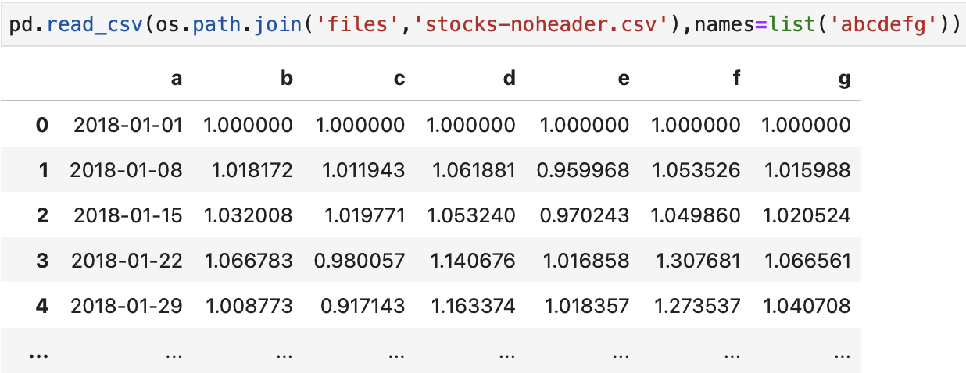
CSV
Use read_csv()
Column names are automatically read if there is a header row
If not, names can be specified

Slide 11
CSV
By default, the index is generated by row numbers
Use index_col parameter to set it to one of the data columns

Slide 12
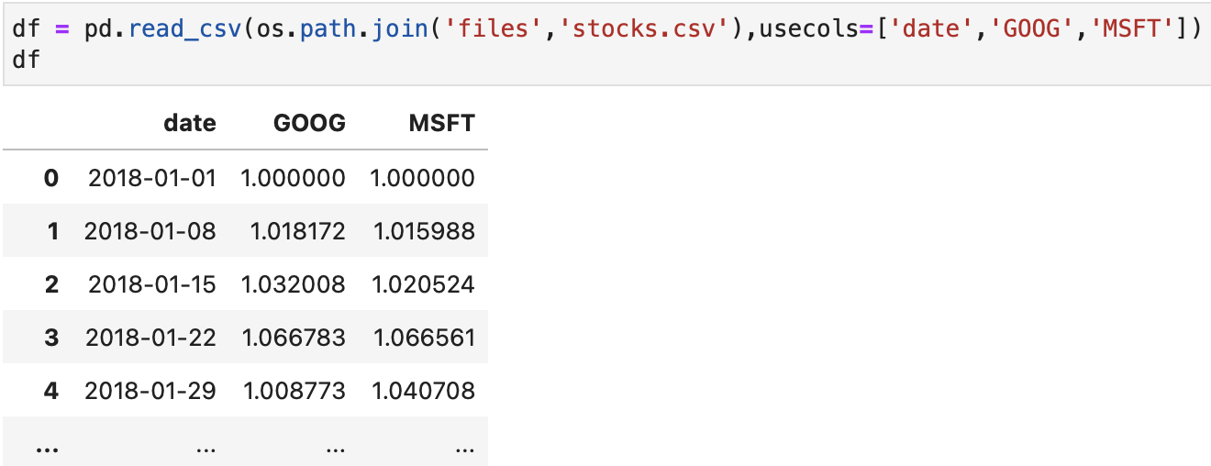
CSV
If you don’t want all of the columns, use usecols to specify the ones to load
Can take a list of numbers for position, or strings for names

Slide 13
CSV
By default, date values are imported as strings in an object column
You can’t do date processing against object
To convert them to datetime objects, use parse_dates
Takes a list of columns to convert to datetime
If columns contain non-dates, it does not convert

Slide 14
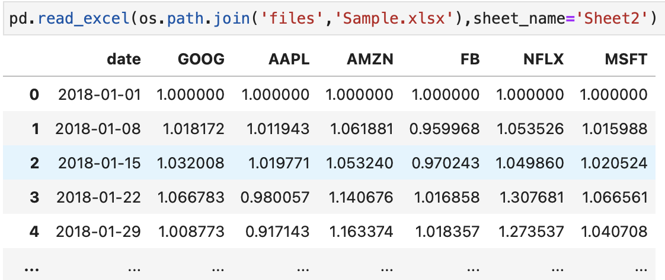
Excel
Use read_excel()
By default reads the first sheet
Pass sheet_name to specify
Can use number or name

Slide 15
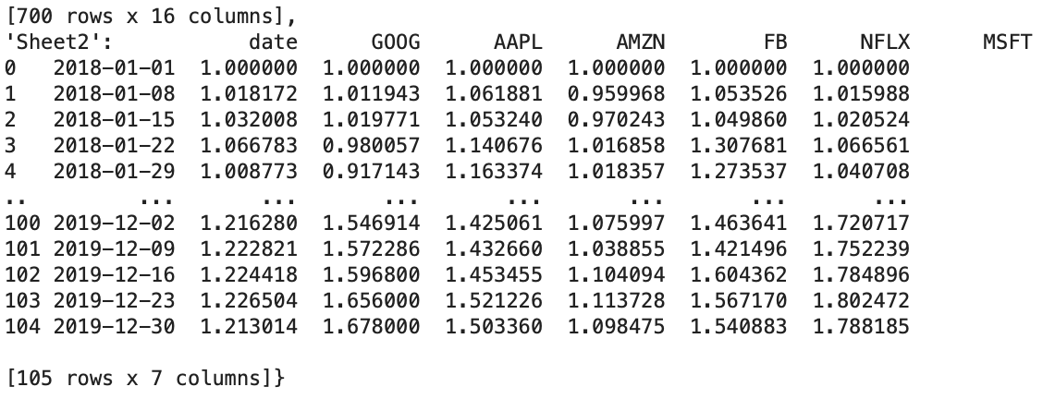
Excel
You can pass a list to sheet_name to load multiple sheets.
Or pass None to load all sheets
It returns one DataFrame per sheet in a dict, with sheet names as keys

Slide 16
Excel
read_excel() has a number of other useful parameters, similar to read_csv():
header – the row to use for column names
index_col – the column to use as the index
usecols – which columns to import
parse_dates – which columns to convert to datetime
skiprows – how many, or list of which rows to skip
nrows - how many rows to load

Slide 17
SQL Database and Others
Use read_sql()
Requires the correct drivers for your database
Requires a connection to be opened already
Varies between different databases
We won’t go over SQL or other formats in class. Contact us for help setting them up outside of class

Slide 18
Displaying DataFrames
If there are too many columns or rows, the dataframe gets truncated using …
This can be prevented by settings:

Slide 19
Describe
Use .describe() to display a table of common calculations
Only includes numeric columns

Slide 20
Selecting Columns
For most columns, they can be selected using .column_name
Some names don’t work, e.g. with a space, or other special characters
Use [“column_name”]

Slide 21
Selecting Rows
Use slicing with []
Returns rows based on position

Slide 22
loc
Use loc[] to select by label/index value
Works for rows and columns in one call:
loc[rows,cols]
For rows – pass index values
For cols – pass column labels
Use slice syntax to specify start and end
Note – unlike slice, end is included when using loc

Slide 23
iloc
Use iloc[] to select by row/column position
Like loc, works for both rows and columns
iloc[rows,columns]
Slicing syntax works here as well
Note again: Important difference - with loc, end is included. With iloc, it is not – like a regular slice

Slide 24
Filtering Rows
Filter expressions can be applied to a DataFrame to return a Series containing True/False for whether each row fits the filter
The results can be passed to the DataFrame selector to return the actual rows

Slide 25
Filtering Rows
Multiple filters can be applied at once
Wrap each condition with ()
Use & for ”and” comparison
Rows that fit all conditions
Use | (vertical pipe) for “or”
Rows that fit any condition

Slide 26
Filtering Rows
Or, you can run one filter at a time
The output of a filter is another DataFrame that can be filtered further

Slide 27
Writing Dataframes To Files
Similar to reading, there are tools to write to many formats:
.to_csv()
.to_excel()
.to_sql()
etc.
By default, it writes the index as part of the data.
Pass index=False to prevent
Default also writes header row
Pass header=False to prevent

Slide 28
Homework
Question and answer format
Download 7 – homework.ipynb from class site
For each question comment, write code to answer

