Slide 1
Beginner Data Science Programming
5. Flow Control

Slide 2
What is Flow Control?
Commands used to control the flow of the program
  Telling the computer what to do next
5 types:
  Normal flow
    Go to the next line down
  Conditional
    Go to one of two lines based on a boolean value (True/False)
  Looping
    Repeat running the same group of lines
  Error Handling
    Go here if an error occurs
  ”With” block
    Used with “closeable” objects to automatically ensure they are closed when finished

Slide 3
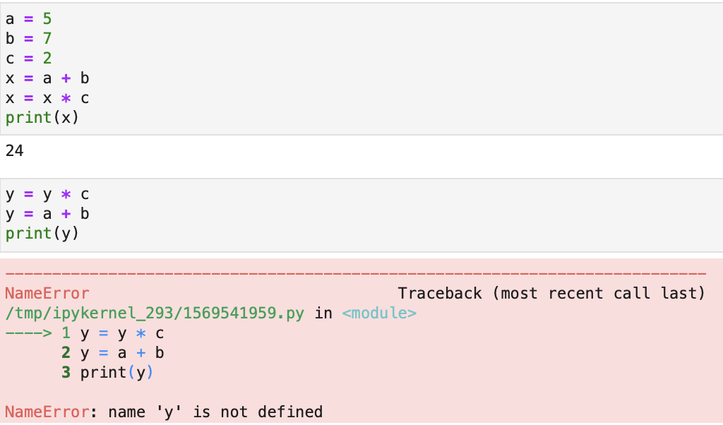
Normal Flow
Normally, the computer just goes to the next line of code
It continues going to the next line until:
  It reaches a conditional or loop statement
  It reaches the end of the program
    The computer stops running the program
  It experiences an error

Slide 4
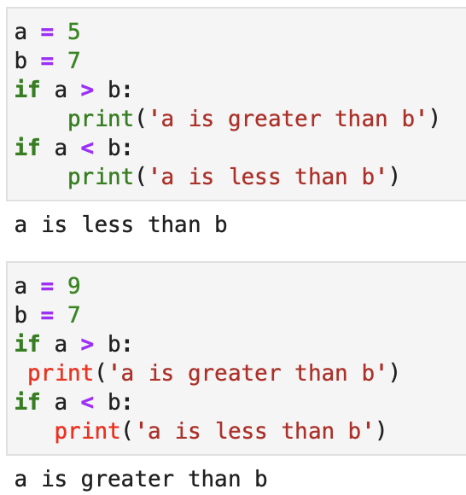
Conditional Flow
Choose the next line based on a boolean value
Defined using if: and indentation
Typically, indent is 4 spaces
  Can use any number, but it is best to keep it the same so the program is easier to read
  Most code editors show this to encourage good practice
  Most editors also convert a tab character to 4 spaces for convenience

Slide 5
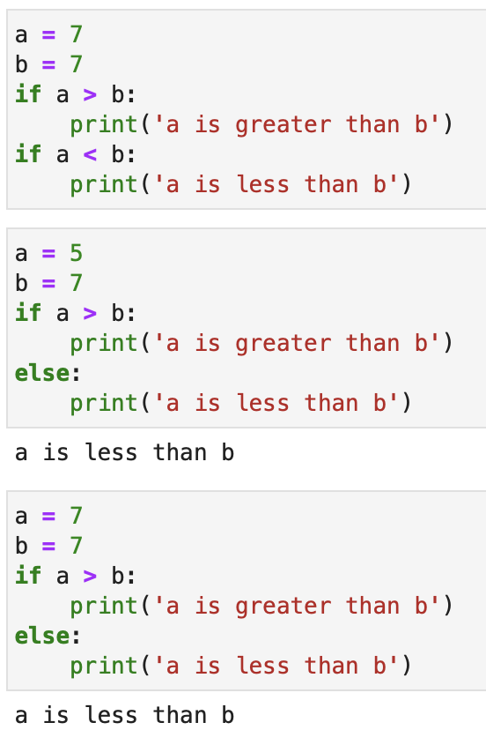
Conditional Flow
So far, we’ve just run code when the value is True
else: - code to run when the value is False

Slide 6
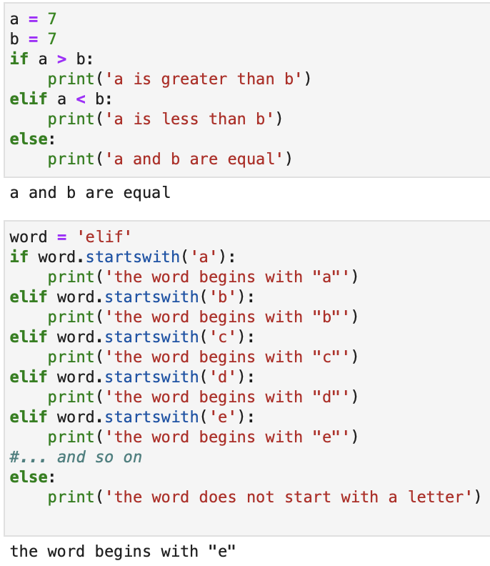
Conditional Flow
What if we want more than 2 choices?
elif: - (short for “else if”)go here when previous value was False, but check another value and decide again
Can use as many elif checks as needed for any number of cases

Slide 7
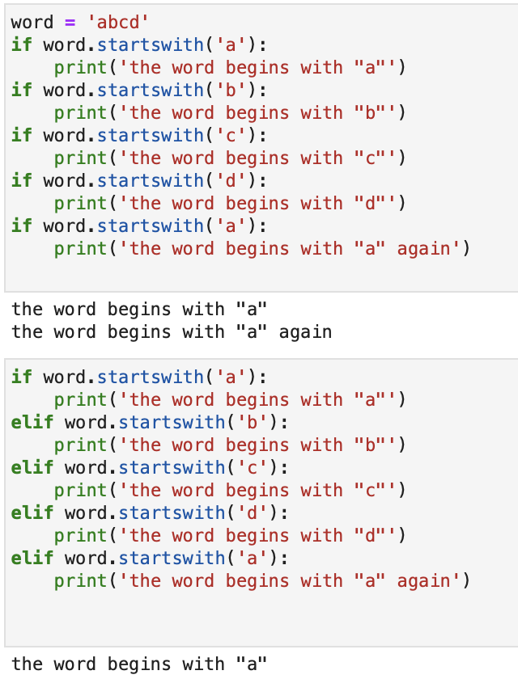
Conditional Flow
Why not just use lots of regular if: statements?
When using regular if:, all checks are run every time
When using elif: the computer will stop checking once it reaches a True value

Slide 8
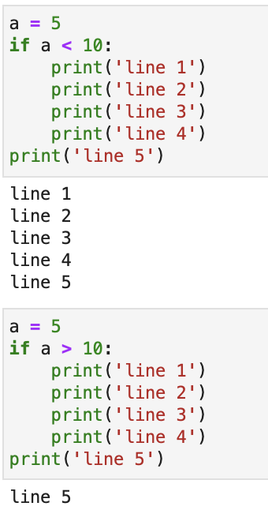
Conditional Flow
Multiple lines can be run from one condition check
  This is called a block
The flow continues as long as the same indentation level continues
When indentation goes back to the previous level, normal flow continues
When False, the flow skips the whole block

Slide 9
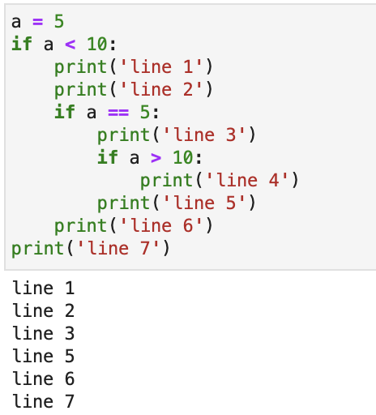
Conditional Flow
You can do another conditional inside a conditional
Indent additional 4 spaces
Same rules apply at every level

Slide 10
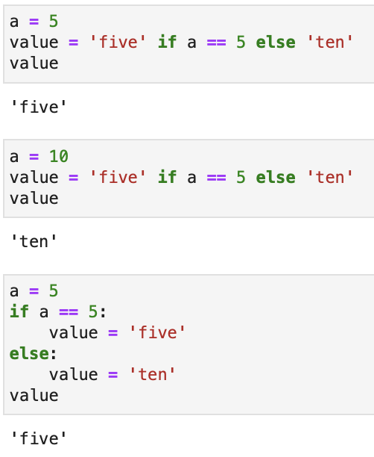
Conditional Flow
Special case – defining a value conditionally
Take the first value if True, otherwise take the second value
Shorter and cleaner than the “normal” way

Slide 11
Loops
Looping - repeat running a block
Defined 2 ways:
  while: - keep repeating while a value is True
  for: - repeat a specified number of times

Slide 12
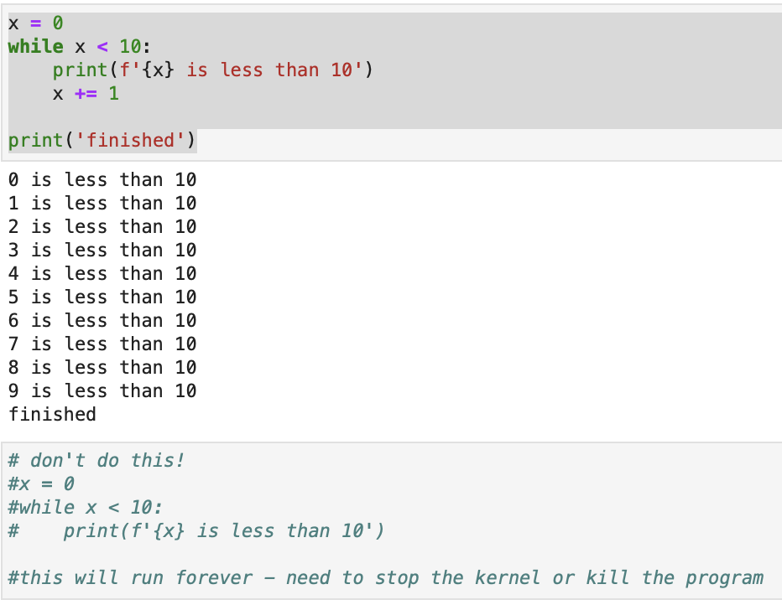
While Loop
while: - similar to if: in that it checks a boolean value
  Instead of running the block once, check again and keep repeating while the value stays True
  When the value is false, skip to the line after the block
Common mistake: not updating the value to be checked
  This will run forever – called infinite loop
  The program will need to be interrupted
    If using Jupyter Notebook, stop the kernel
    If on command line, press control and c keys together

Slide 13
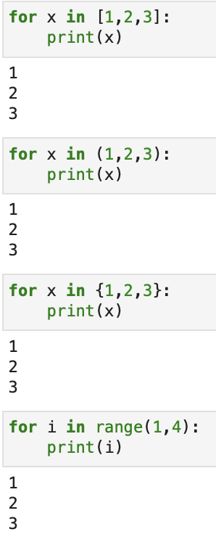
For Loop
for/in: - Repeat a block a specified number of times
Takes any iterable – something that has multiple items that can be processed one-by-one
  list, tuple, dictionary, set
  generator – acts like a list, but the values are not actually in memory

Slide 14
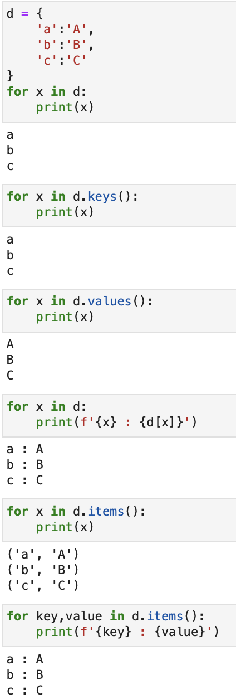
For Loop With Dictionary
Looping over a dictionary has some special cases
  Looping directly just returns the keys
    Can also explicitly get the keys using .keys()
  Using .values() returns just the values
  To return both, there are two ways:
    Index into the dict during the loop
    Loop over .items() which returns tuples containing key & value
  Tuple unpacking also works while looping

Slide 15
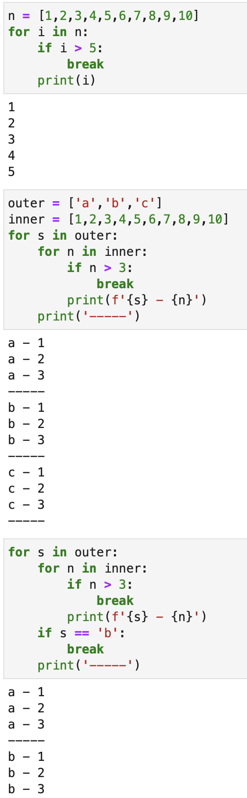
Special Loop Statements
break – stop looping without finishing
Breaks current loop only
To break outer loop, you need to do another break statement

Slide 16
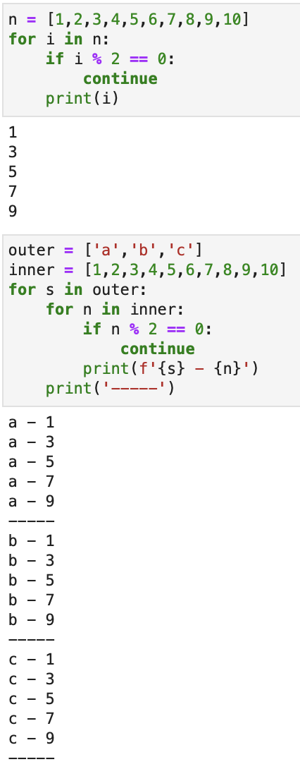
Special Loop Statements
continue – stop the current loop iteration and continue with the next item
Like break, also only operates on current loop

Slide 17
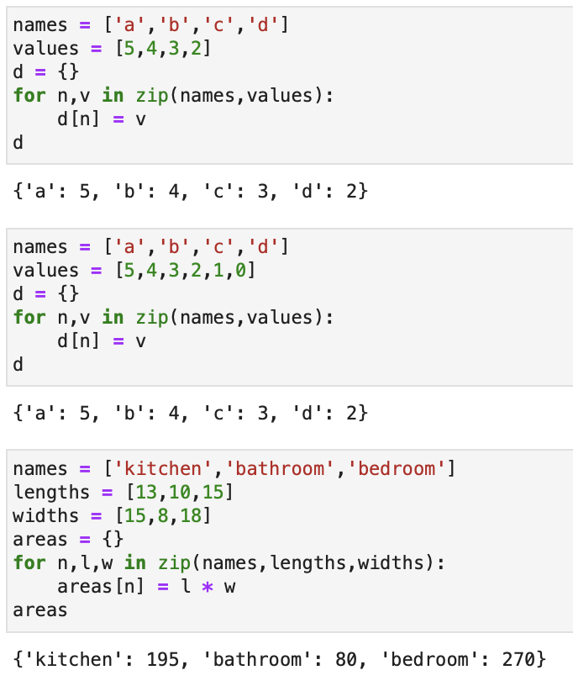
Loop over multiple lists
zip() - Combines multiple lists into one list of tuples, with one item from each list in order
Can unpack directly in the loop
Lists should be the same length
  If not, it will stop when it reaches the end of the shortest one
You can use any number of lists

Slide 18
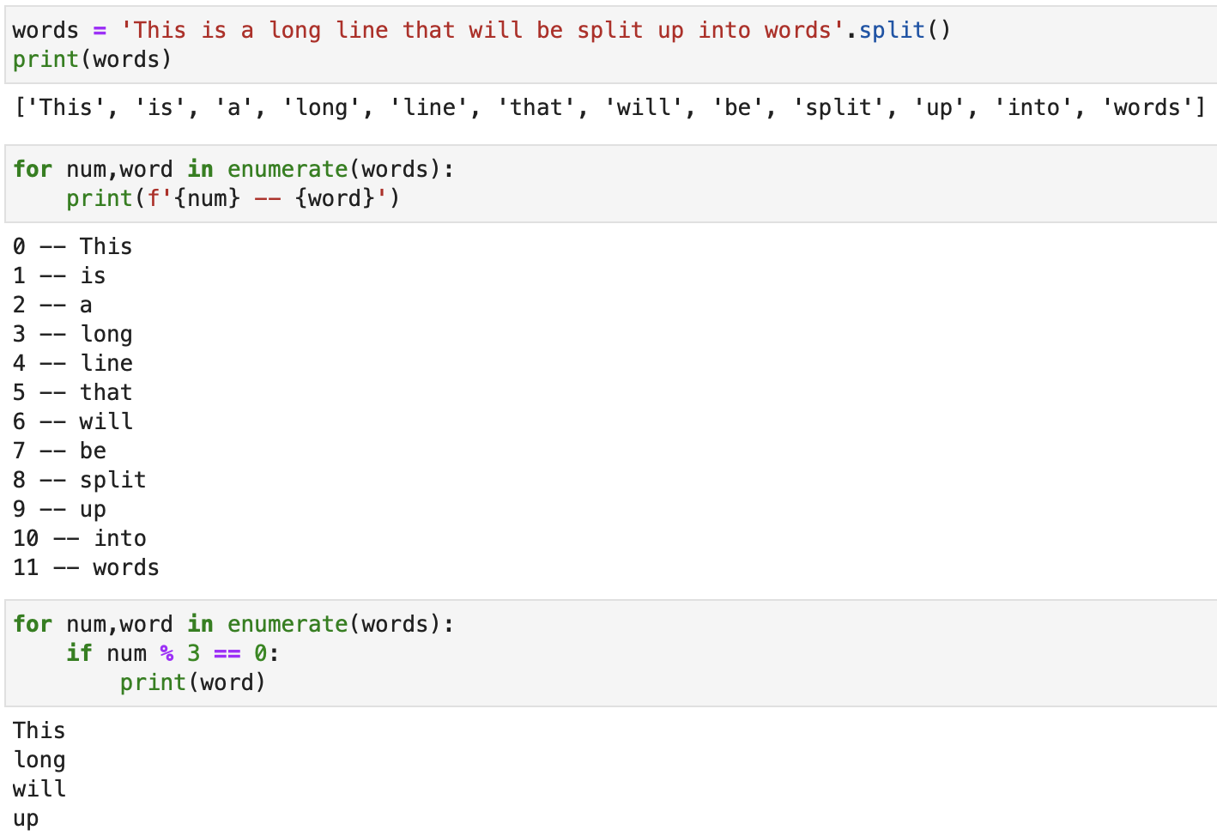
Loop with index
enumerate() – generate tuples containing the index and value
Useful for when you need to know the position and not just the values
Example: print every 3rd word of a sentence

Slide 19
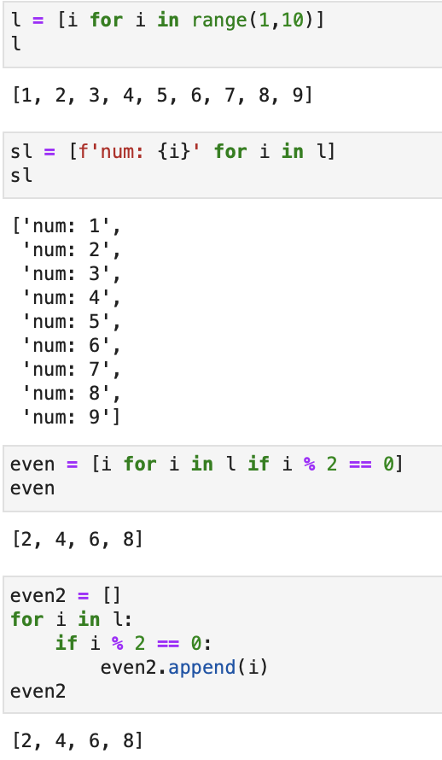
List Comprehension
A special type of for loop used to build lists
Can use any single expression
Can use a conditional
Really just shortcut for regular for loop with append

Slide 20
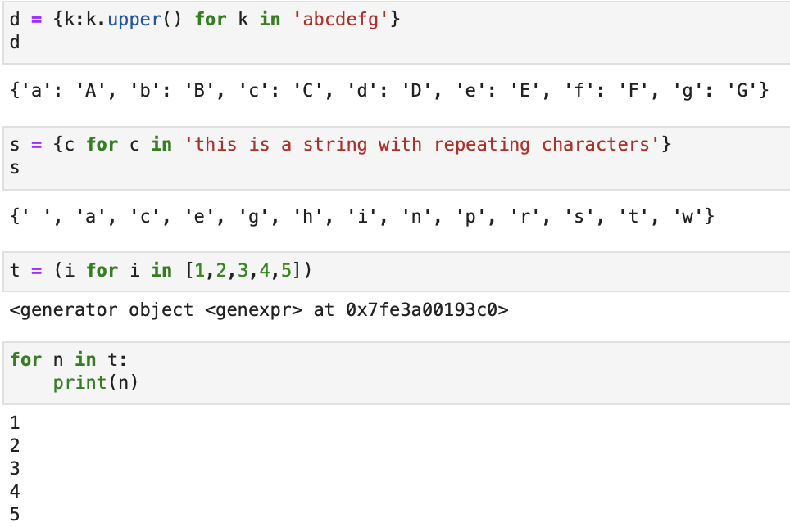
Other Comprehensions
Comprehensions can also be used for dict, set, tuple
Notes:
  dict – you need to specify both key and value
  tuple – it actually creates a generator object
    Loop over the generator to expand the values

Slide 21
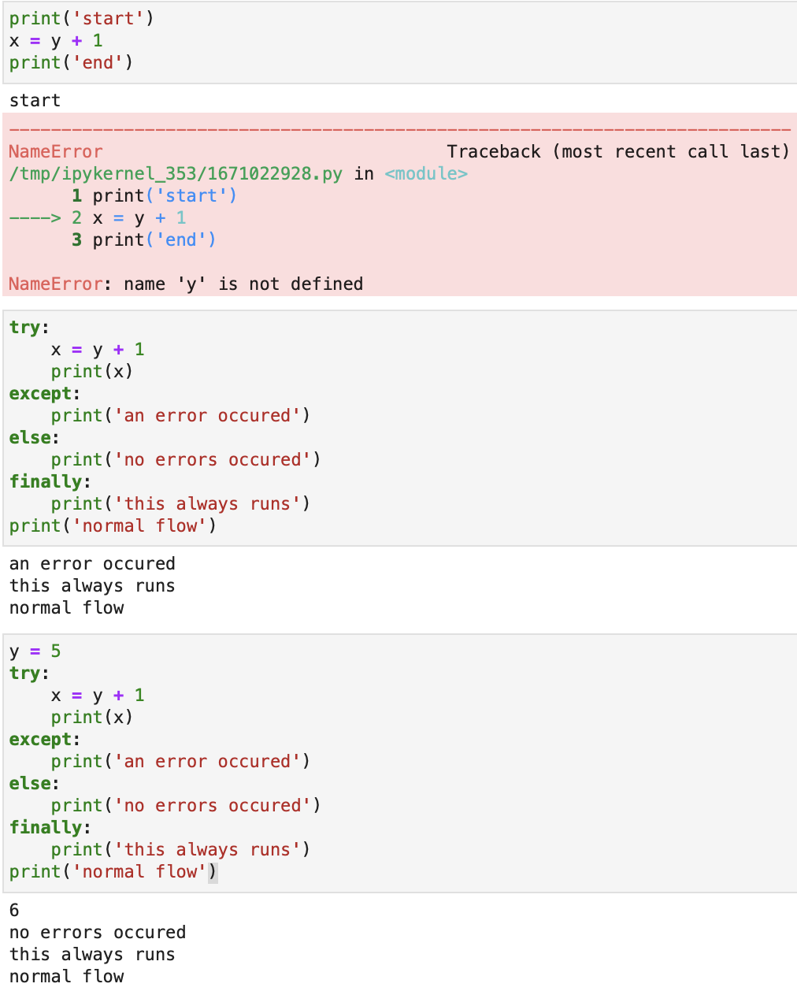
Error Handling
Normally when an error occurs, also called exception, the program quits
Instead, you can have code handle the error and the program can continue
Uses 4 parts:
  try: - the block that can cause the error
  except: - the block that runs when an error occurs
  else: - optional - a block that runs after try, only if no errors occur
  finally: - optional - a block that always runs at the end, whether an error occurs or not
Flow continues normally afterwards

Slide 22
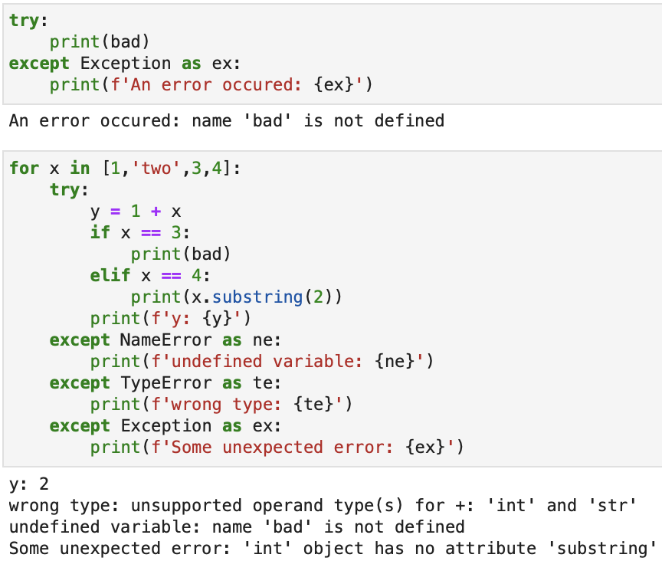
Error Handling
Information about the error can optionally be used
Different types of errors can be handled differently using multiple except: blocks
Exception matches any error

Slide 23
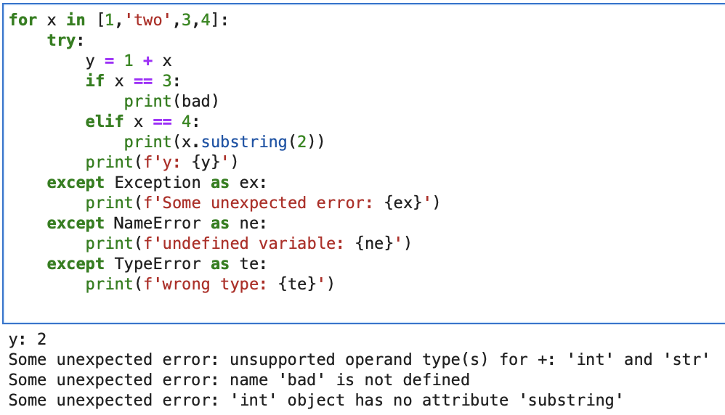
Error Handling
Order matters – it checks top to bottom and runs the first one that matches

Slide 24
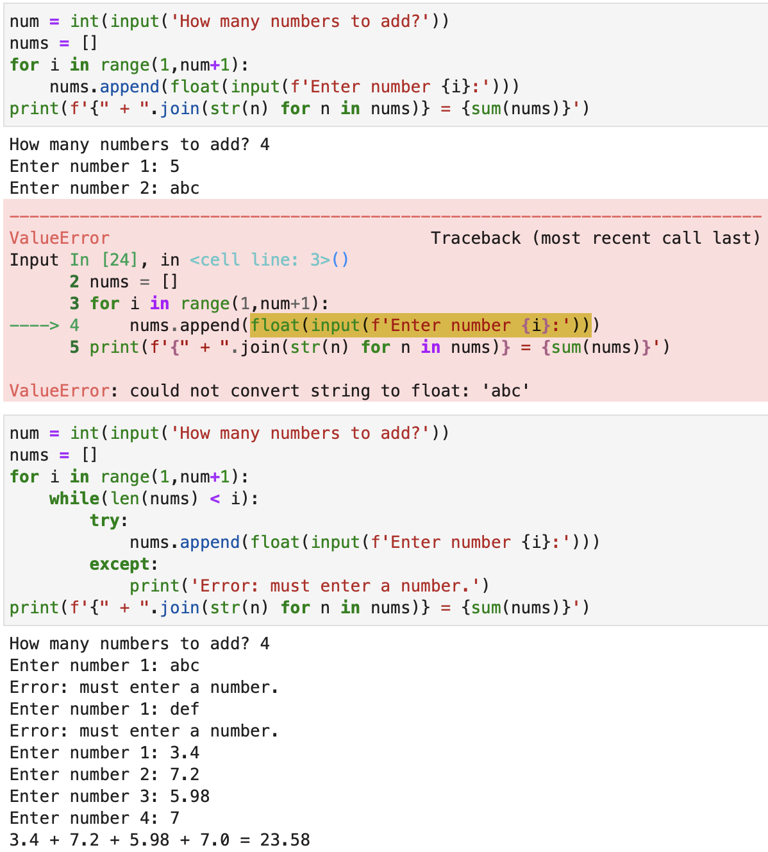
Combine Error Handling With Loops
Handling errors inside loops lets the program continue and try again
Useful for validating user input

Slide 25
Homework – Continue Improving Gas Program
Use loops to enter the info instead of multiple input lines
Let the user choose how many cars and trips
In addition to distance and gas, also input a car number
  Should be non-sequential e.g. 15, 9, 21,… like entrants in a race
Print a message saying which car had the best mileage
Optional Bonus items:
  Handle the error if a user enters non-numeric values, and ask again
  If multiple cars tie for the best, print them all
NOTE: No Class next week (8/24/2023)

