Slide 1
Data Science Programming
Curriculum Overview

Slide 2
Data Science Programming Class Overview
Three course levels:
101 – Beginner
201 – Intermediate
301 – Advanced
No experience required for 101
If you do have experience, useful to refresh and expand
Each course builds on the previous

Slide 3
101 - Beginner
Python Introduction and Environment setup
Python Language Basics
Python Language Basics Continued
Complex Types
Flow Control
Modules
Pandas - read, display, write tabular data
Pandas - manipulate and analyze tabular data
Plotly - draw charts/graphs of tabular data
Learn the basics of Data Science through computer programming. With no previous experience required, students learn how to instruct the computer to perform the tasks and calculations needed to analyze and summarize data. Learn concepts like variables, input/output, and loops/flow control. Read data in from files, perform calculations, and display simple charts.

Slide 4
201 - Intermediate
Review of beginner concepts, Environment setup/checkup, Intro to intermediate topics
Functions & Classes
Multiple Files: Modules & Packages
Pandas – advanced processing
Plotly – advanced plots & subplots
Dash - Intro and simple layouts
Dash - Callbacks and Interactivity
Converting notebooks to standalone programs
Running on schedule or as a continuous service
Expand upon the beginner course to learn higher level programming concepts like functions, classes, and multi-file programs. Perform advanced processing and analysis over DataFrames, and design more complex visualizations. Layout multiple visualizations into dashboards and turn interactive notebooks into standalone programs that can run continuously or on schedule.

Slide 5
301 - Advanced
Welcome and Intro to Machine Learning - Overview of all categories, and deep dive into Supervised Regression
Build machine. In-depth description of machine & its components.
Introduce Arduino & CircuitPython, ensure needed software is installed.
Program the control unit
Program the data recorder
Gather and examine test data. Make improvements to programs.
Gather “final” data. Clean up and prepare data for ML. Set up and train the candidate ML algorithms. Select one to use.
Run the selected algorithm over remaining data and compare results
Explore Machine Learning through this hands-on workshop. Learn about the many categories of Machine Learning and experience the complete end-to-end application of one of those categories - Supervised Regression. Assemble a small machine with electric motor, belt drive, sensors, and control unit. Adjust the belt tension to simulate performance tuning. Program the control unit to read the sensors and report the data. Write another program to receive and record the data. Finally, use this data to train and test machine learning algorithms to predict the output speed based on the belt tension.

Slide 6
Beginner Data Science Programming
1. Python Introduction and Environment Setup

Slide 7
What is programming?
Creating instructions for a computer to make it perform tasks
Program – a stored set of instructions that can be executed
Language – The words and symbols used to make the instructions
Ex: Java, C++, C#, PHP, Python

Slide 8
Python
Easy to learn - Programs are similar to regular English language
Powerful – Can perform the most complex tasks over very large data sets with good performance.
Runs almost anywhere – Mac, Windows, Linux, Embedded devices
Huge ecosystem of libraries – code written by others that does common tasks, usable by your programs.

Slide 9
Example

Slide 10
Example

Slide 11
Example

Slide 12
How to Run Python Programs
Interpreter – Reads Python code and interprets it, converting it into machine code which is actually what the computer runs
Two modes:
Interactive
Non-Interactive

Slide 13
Interactive
You type in code and it runs each line immediately:
# python
Python 3.8.12 (default, Oct 12 2021, 03:05:25)
[GCC 10.2.1 20210110] on linux
Type "help", "copyright", "credits" or "license" for more information.
>>> 123 + 456
579
>>> numbers = [123,456,789,10]
>>> total = 0
>>> for n in numbers:
... total += n
...
>>> total
1378
>>>

Slide 14
Non-Interactive
Code is saved in a file, which is run as one unit:
# python example.py
The sum of 123 and 456 is 579
#

Slide 15
Comparison
Interactive
Non-Interactive
Pros:
Immediate results
Quick and easy to try out ideas
No prep needed – just start typing
Cons:
You have to re-type code to re-run it
Code is not saved after quitting
Difficult to do anything even moderately complex
Errors can’t be fixed – must be retyped
Pros:
Code is saved in a file
Rerun many times easily
Complex code is manageable
Cons:
Need to run entire code at once
Simple tasks have lots of overhead (edit file, run, edit file, run, etc.)

Slide 16
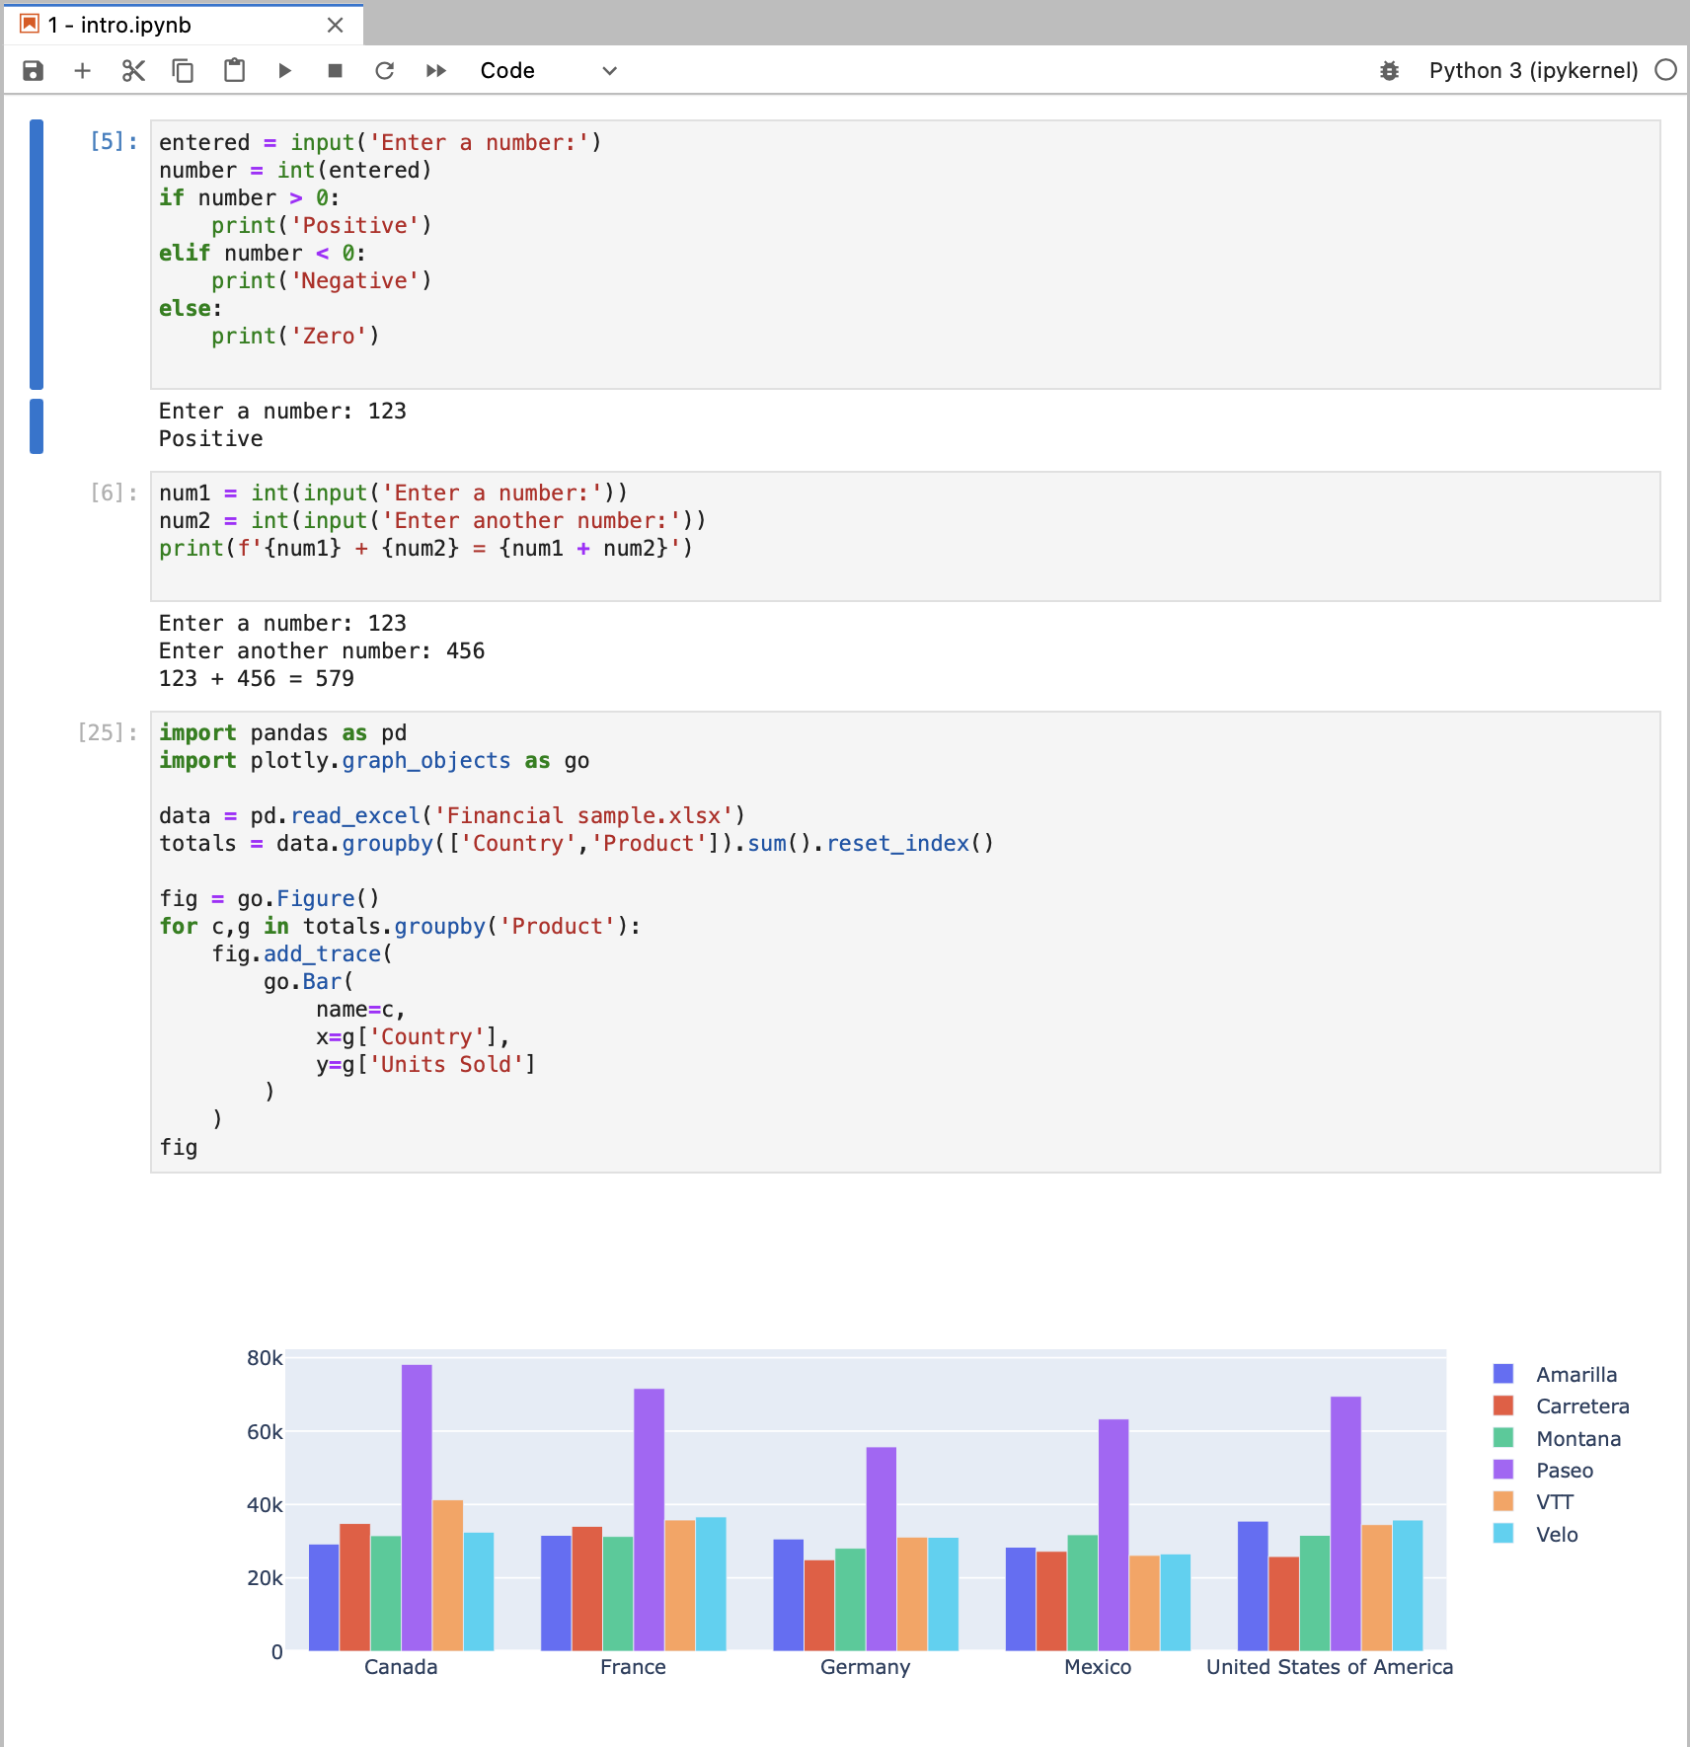
Hybrid – Jupyter Notebook
Blend of both Interactive and Non-Interactive
Interactive –
Can run each section immediately
Easy to test out new ideas
Non-Interactive –
Code is saved in a file
Errors can be fixed and rerun
Complex code is more manageable

Slide 17
Anaconda
“Companion” to plain Python
Bundles lots of software and libraries to ease their installation and management
Geared toward a focus on Data Science tools
To install: https://anaconda.org
Once installed, run: Anaconda Navigator
Windows: Start menu
Mac: Applications Folder

Slide 18
Anaconda Navigator
Create and manage Python Virtual Environments –named configurations that specify:
Python version
Installed libraries
Installed tools
Notes:
Switch to live anaconda navigator to show examples

Slide 19
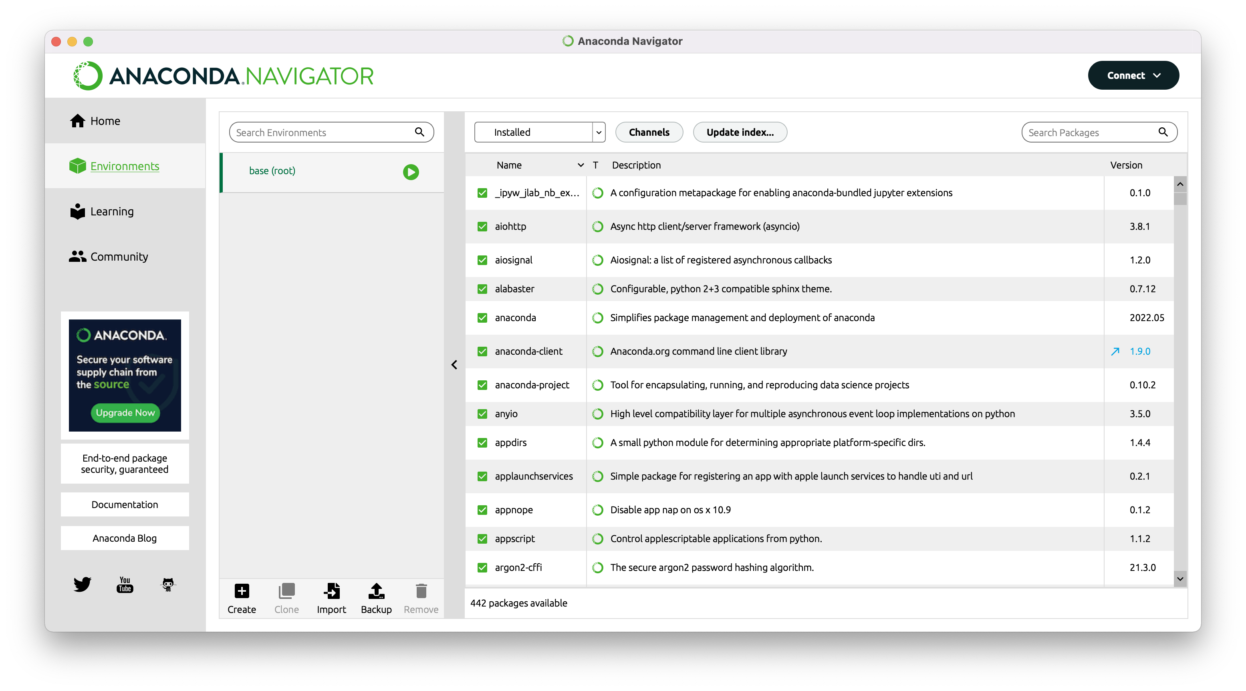
Create Environment
Select Environments
Click Create
Name: ds2023
1
2

Slide 20
Install Libraries
Click Update Index…
In the dropdown, select “Not installed”
In the search box type the name of the library
Select the box to mark for install
Repeat for all these libraries:
pandas
plotly
openpyxl
xlrd
matplotlib
statsmodels
ipywidgets
Click Apply
2
1
3
4
6

Slide 21
Install Tools
Select the Home tab
Make sure ds2023 is selected in the dropdown
Install Jupyter Notebook
1
2
3

Slide 22
Run Jupyter Notebook
Once it is installed, it will change to have a blue Launch button
1

Slide 23
Run Jupyter Notebook
When launched it shows your home directory
You can open an existing notebook (*.ipynb)
Or click the New button at top right to create a new notebook

Slide 24
Class Website
We have set up a website to host all materials for this class:
https://pages.process-solutions-group.com/sites/ds2023/
Log in with the provided username/password
After each session, the presentation and example code/files will be posted

Slide 25
Homework: run example code
Login to the class website
Find entry for this class:
1. Python Introduction and Environment Setup
Download the example code and data file:
1 - intro.ipynb
Financial Sample.xlsx
Open it in Jupyter Notebook, and select the Run All button:
It should run and produce the output at right
If not, contact me for help setting up your system

